Slide 1
Secretary’s Report 2024
AGM 12 May 2024

Slide 2
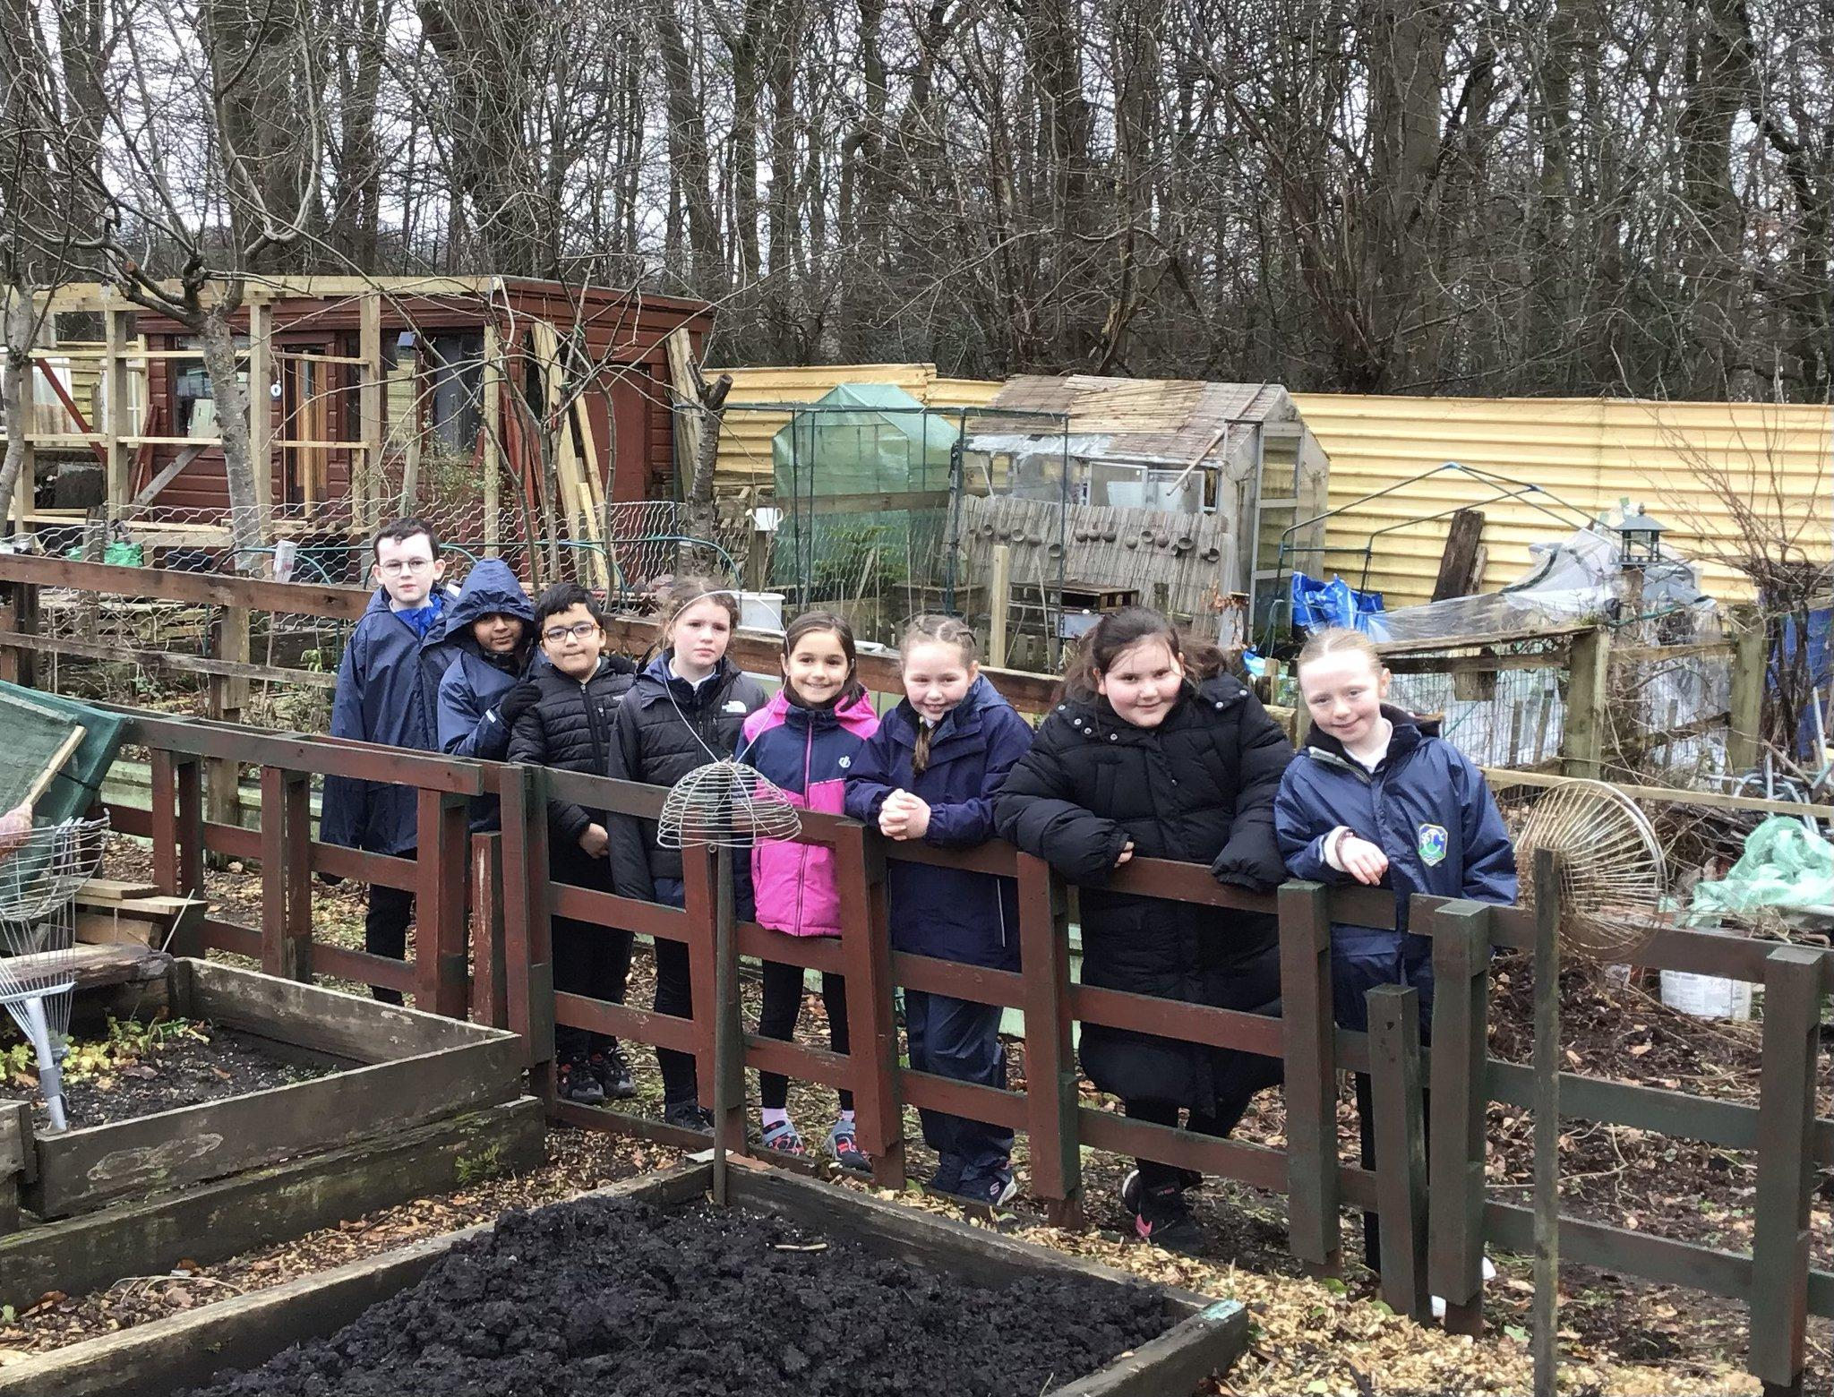
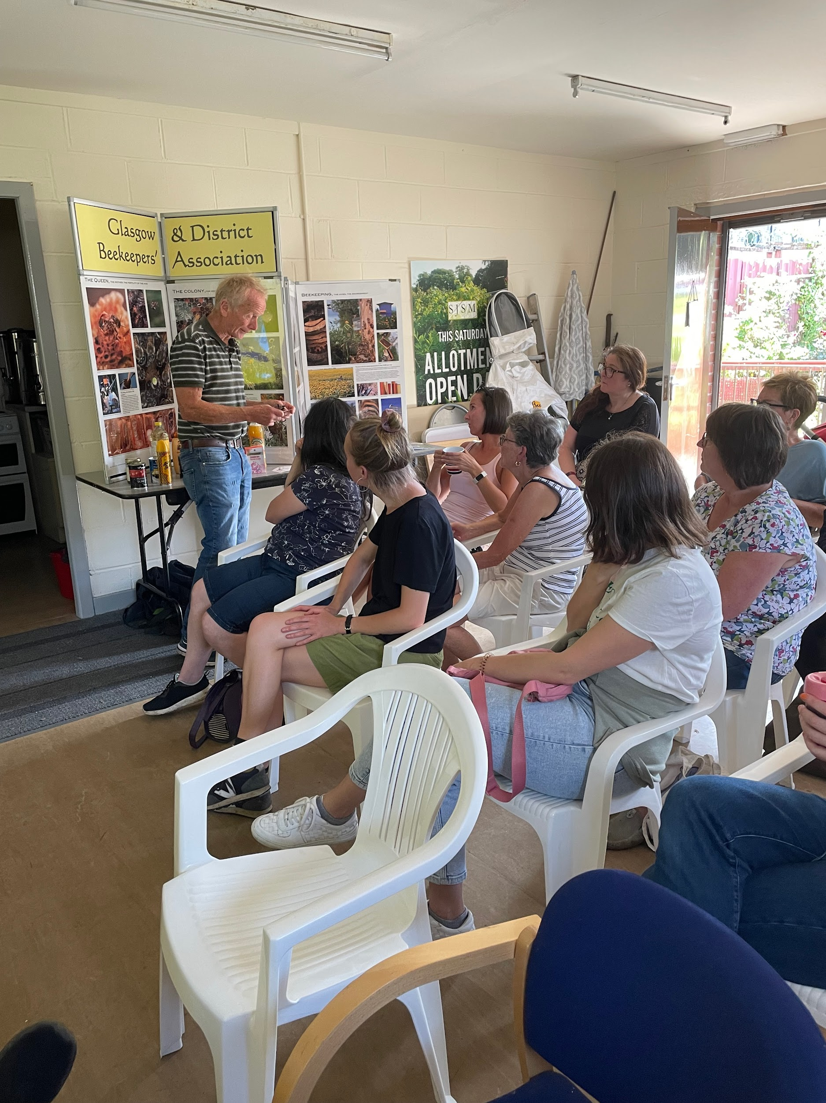
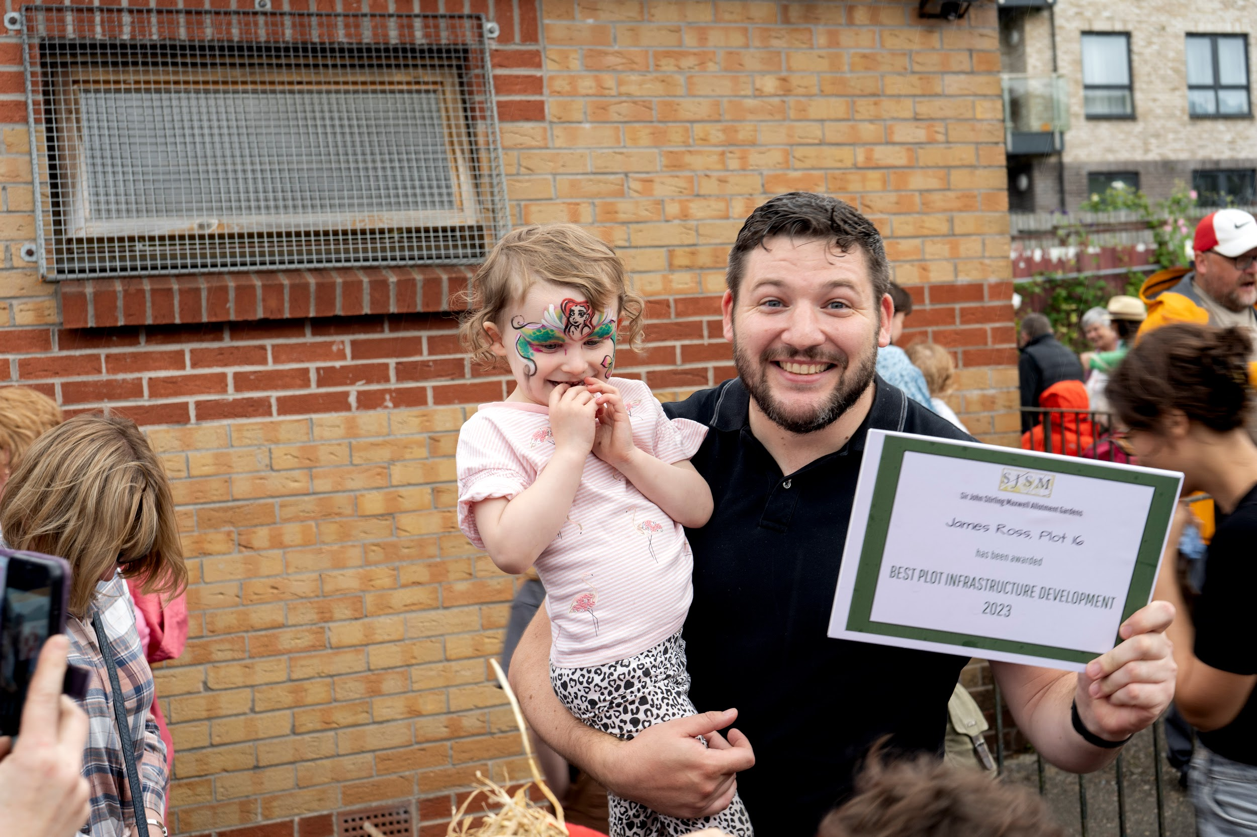
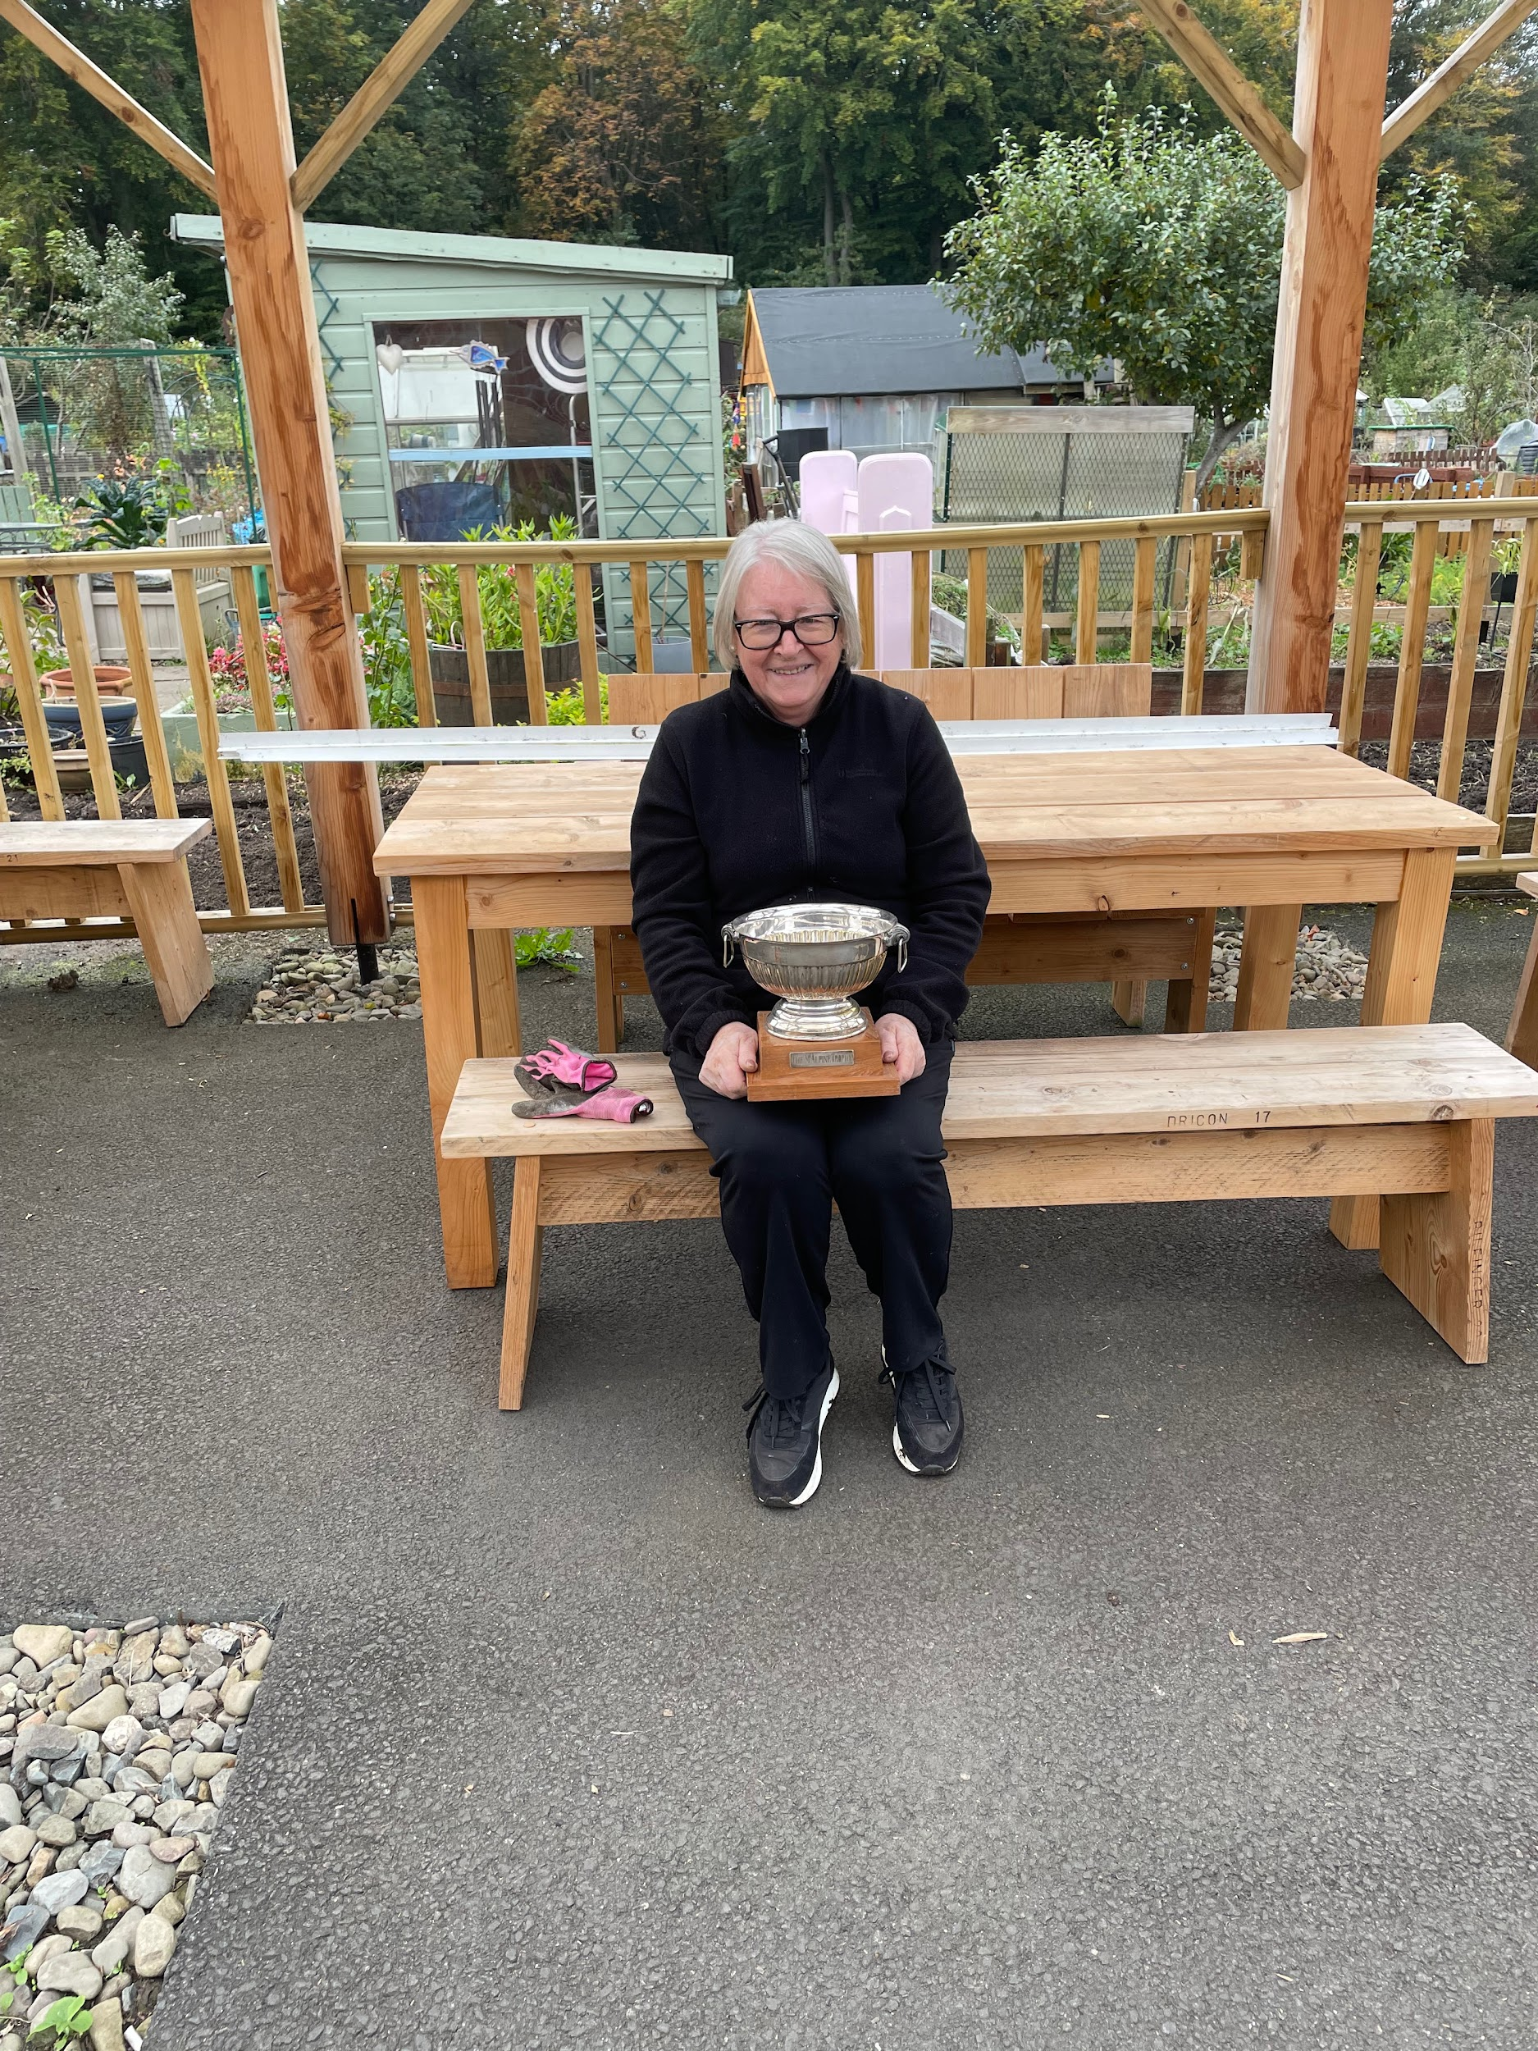
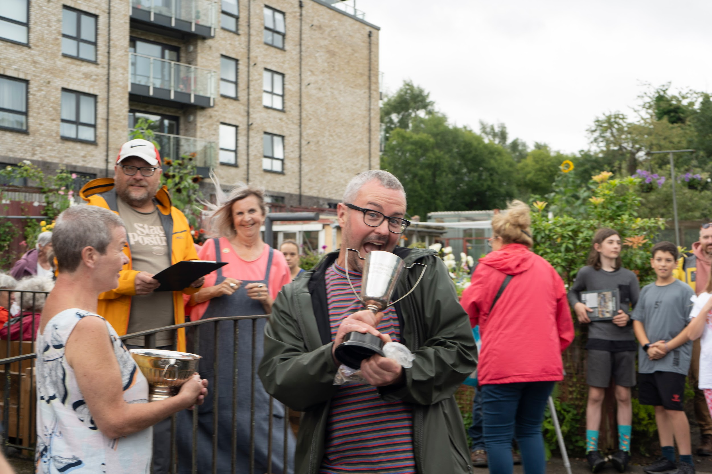
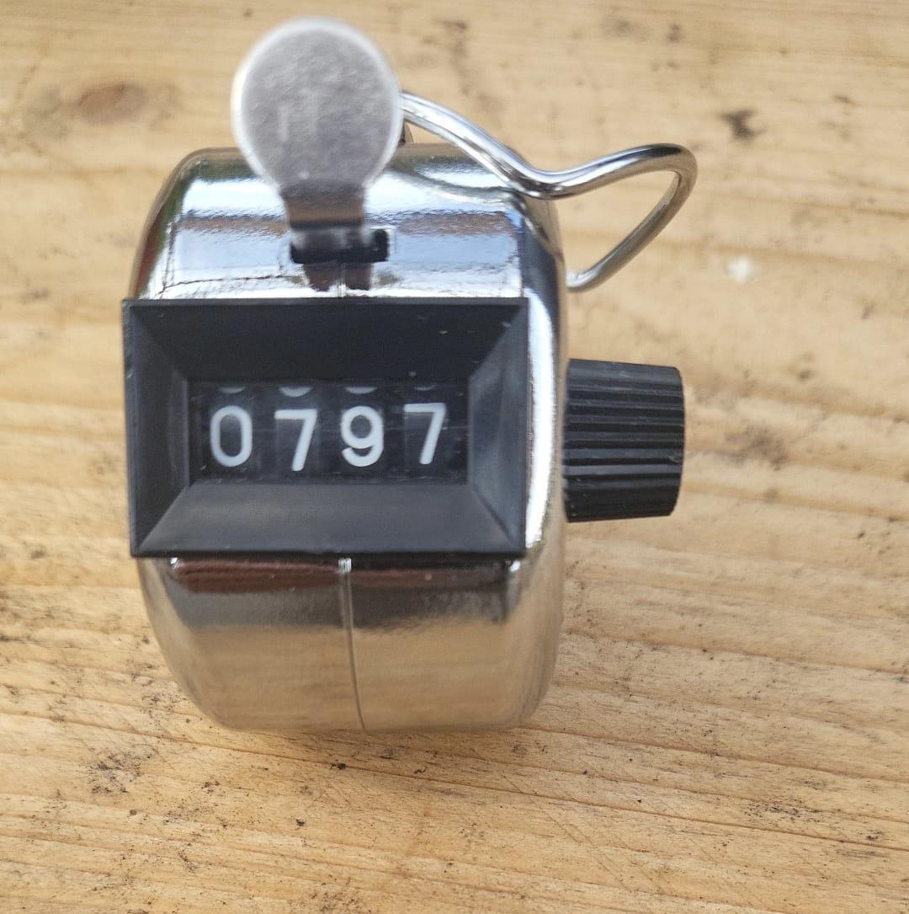
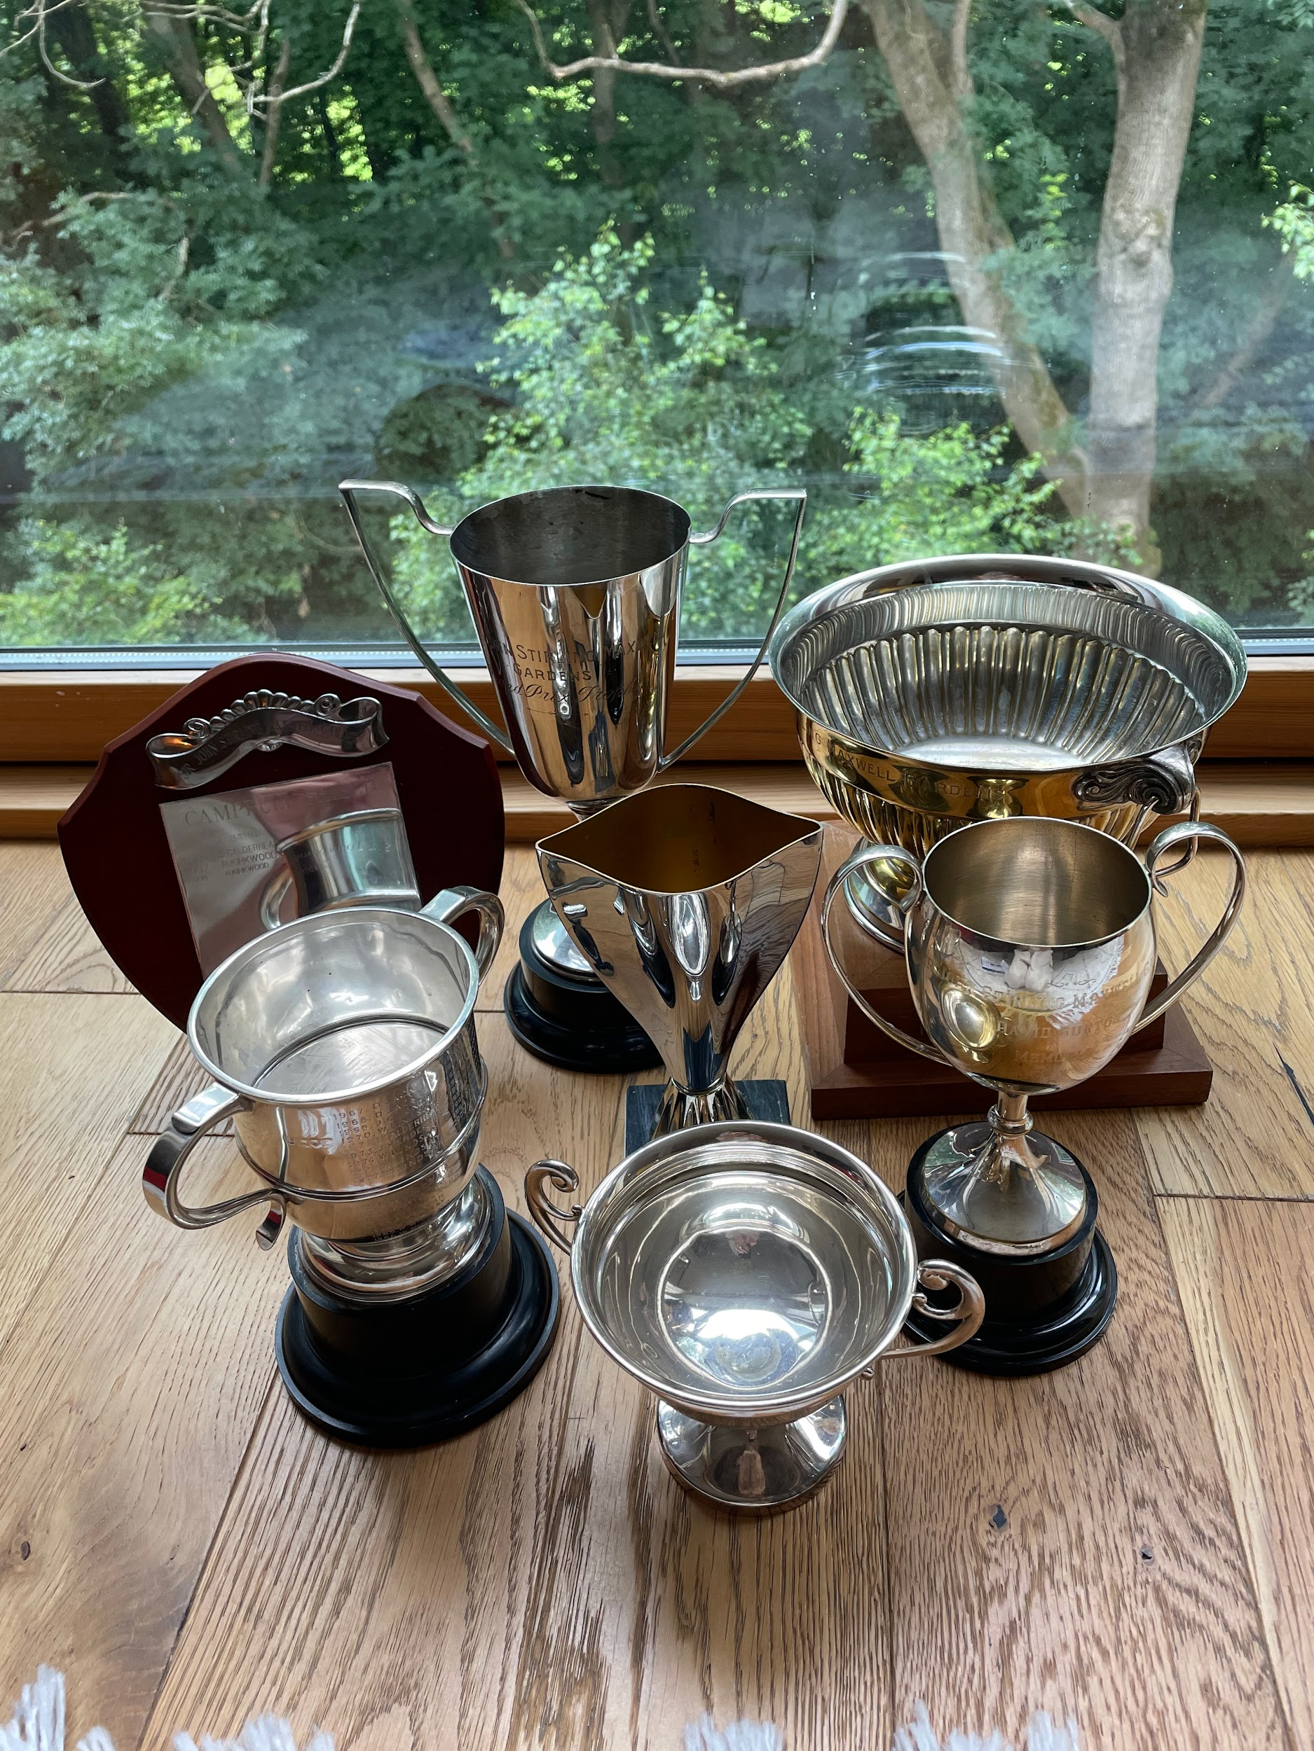
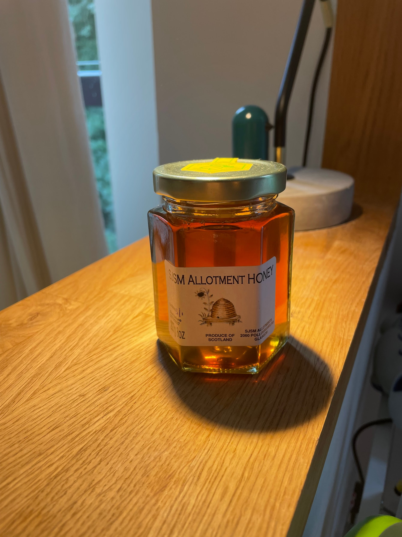
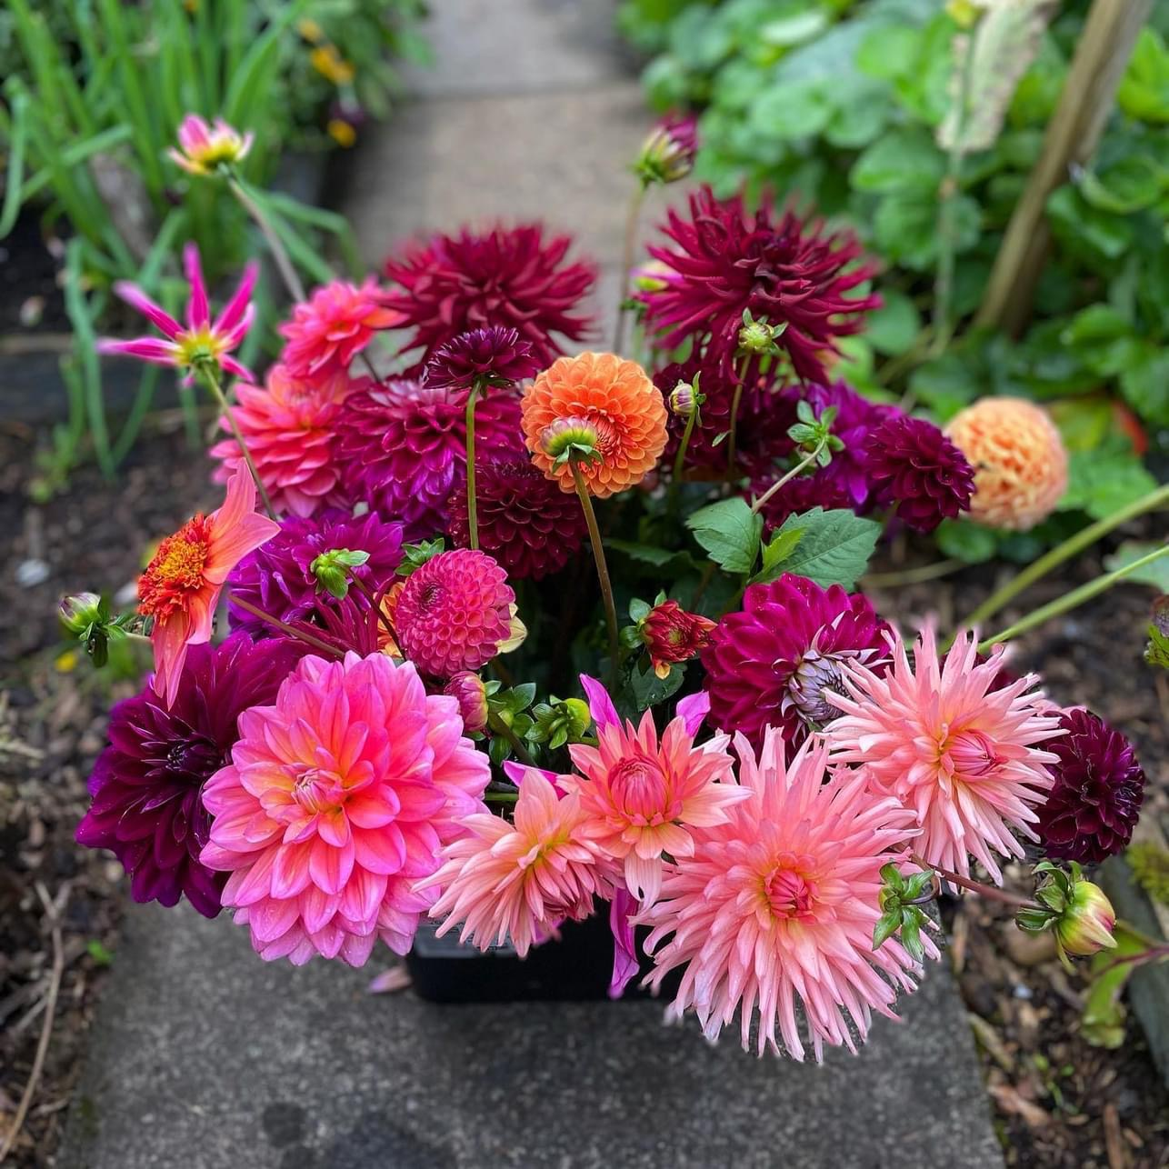
Highlights:
Open Day 797 visitors and £5.8k in takings
27 Associate members to date
Plot standards & awards
Plot Inspections process
Infrastructure work complete
Sense of Community
Beekeeping project
GCVS grant for Women’s Workshops
School visit
Pavilion Team: Julie D & Ann C

Slide 3
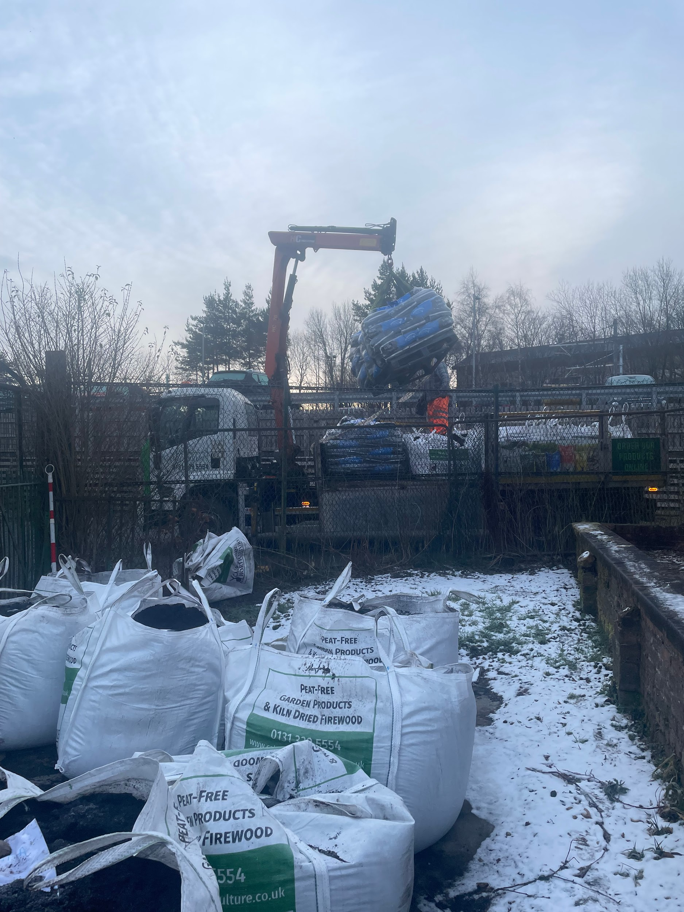
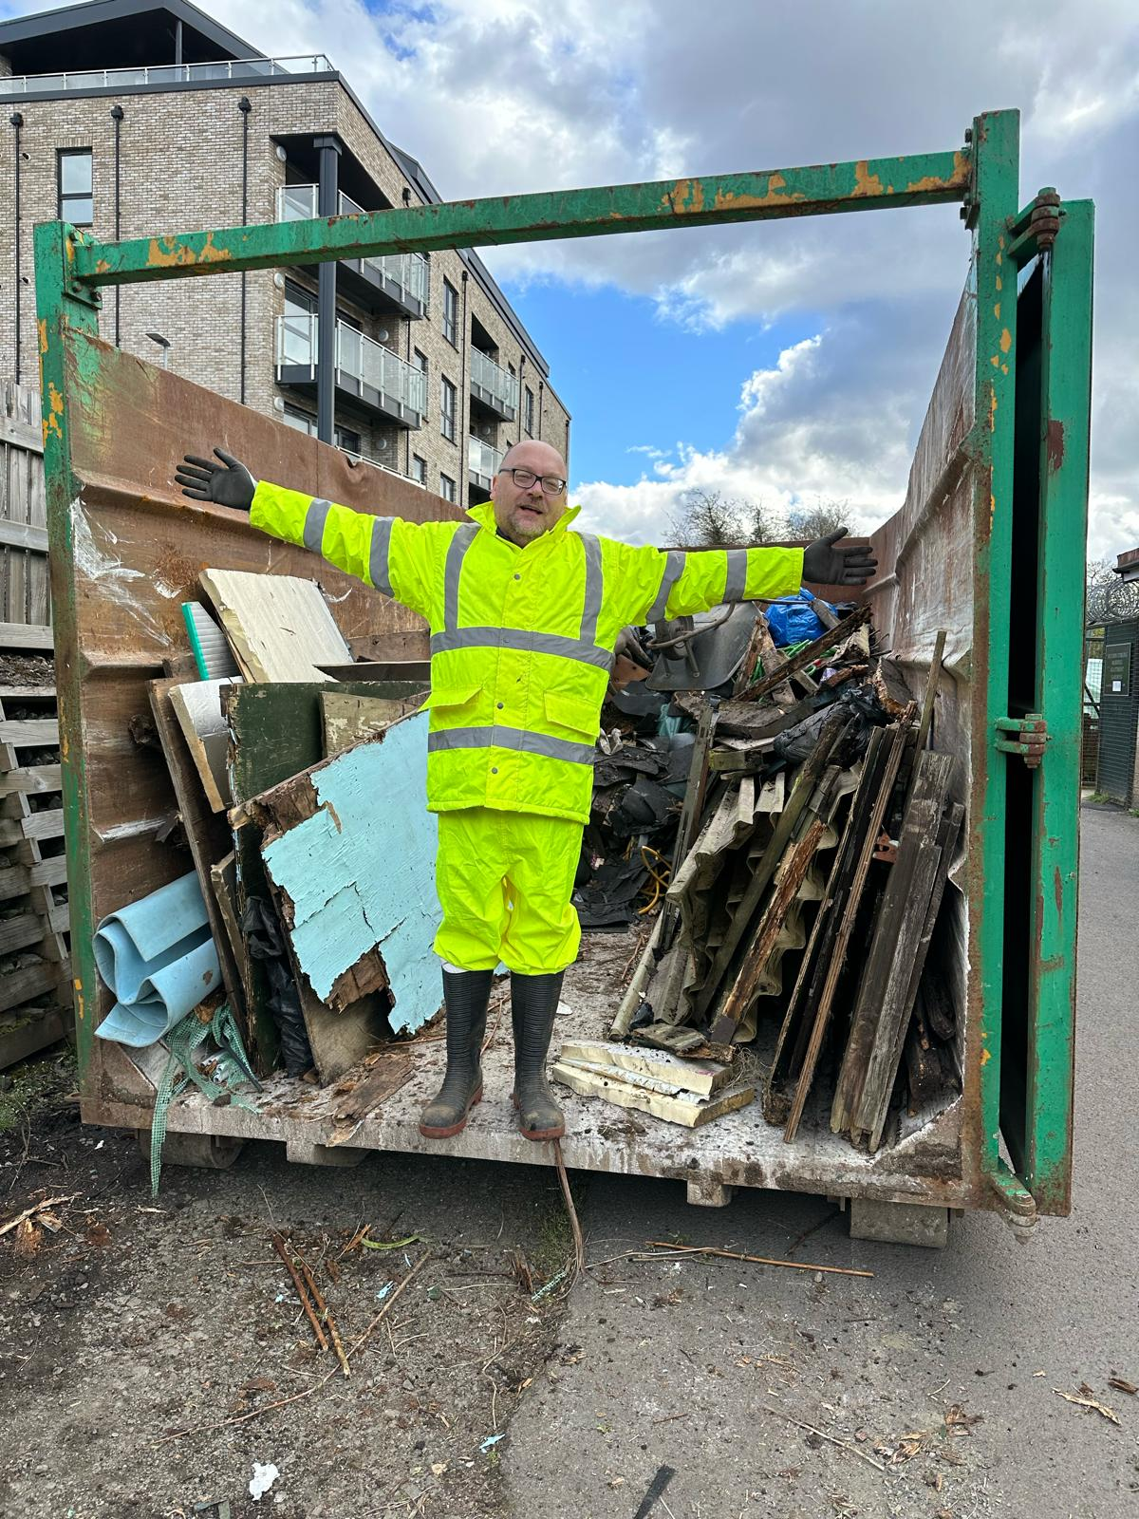
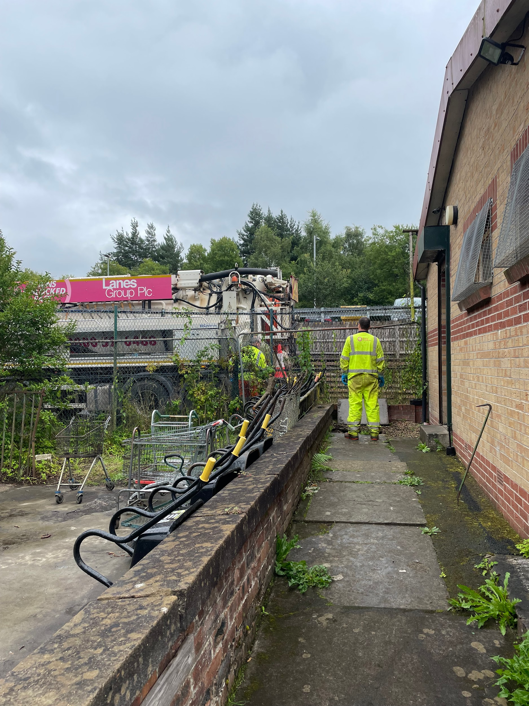
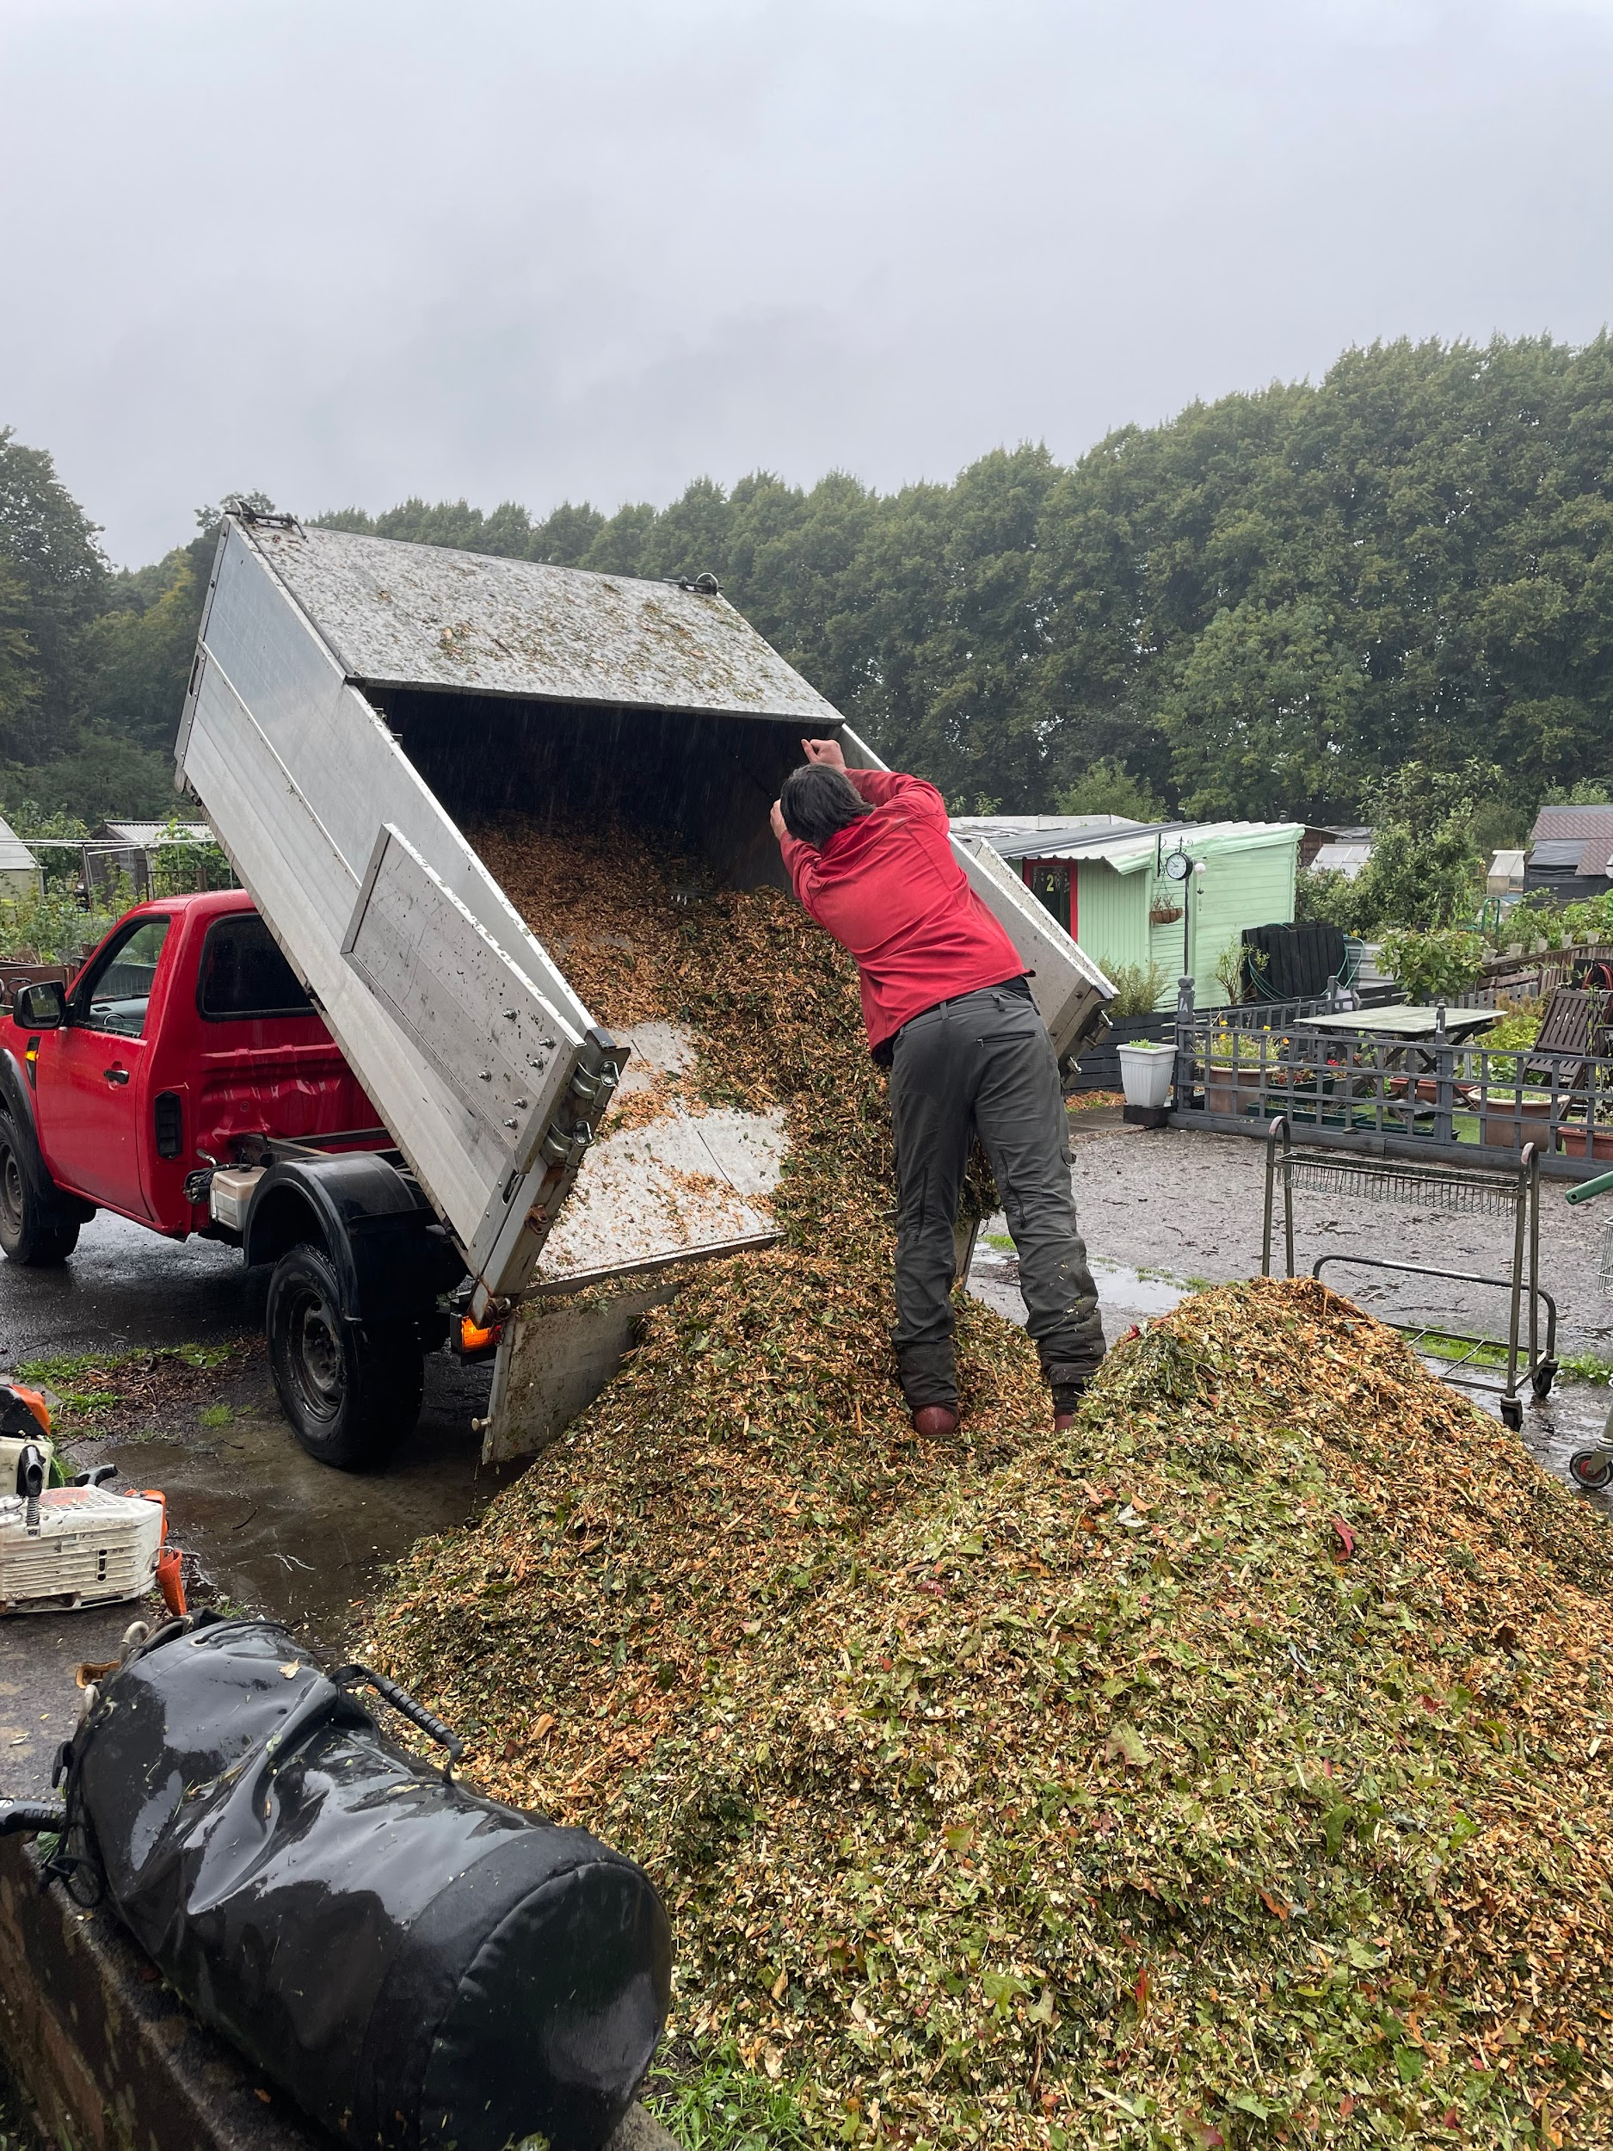
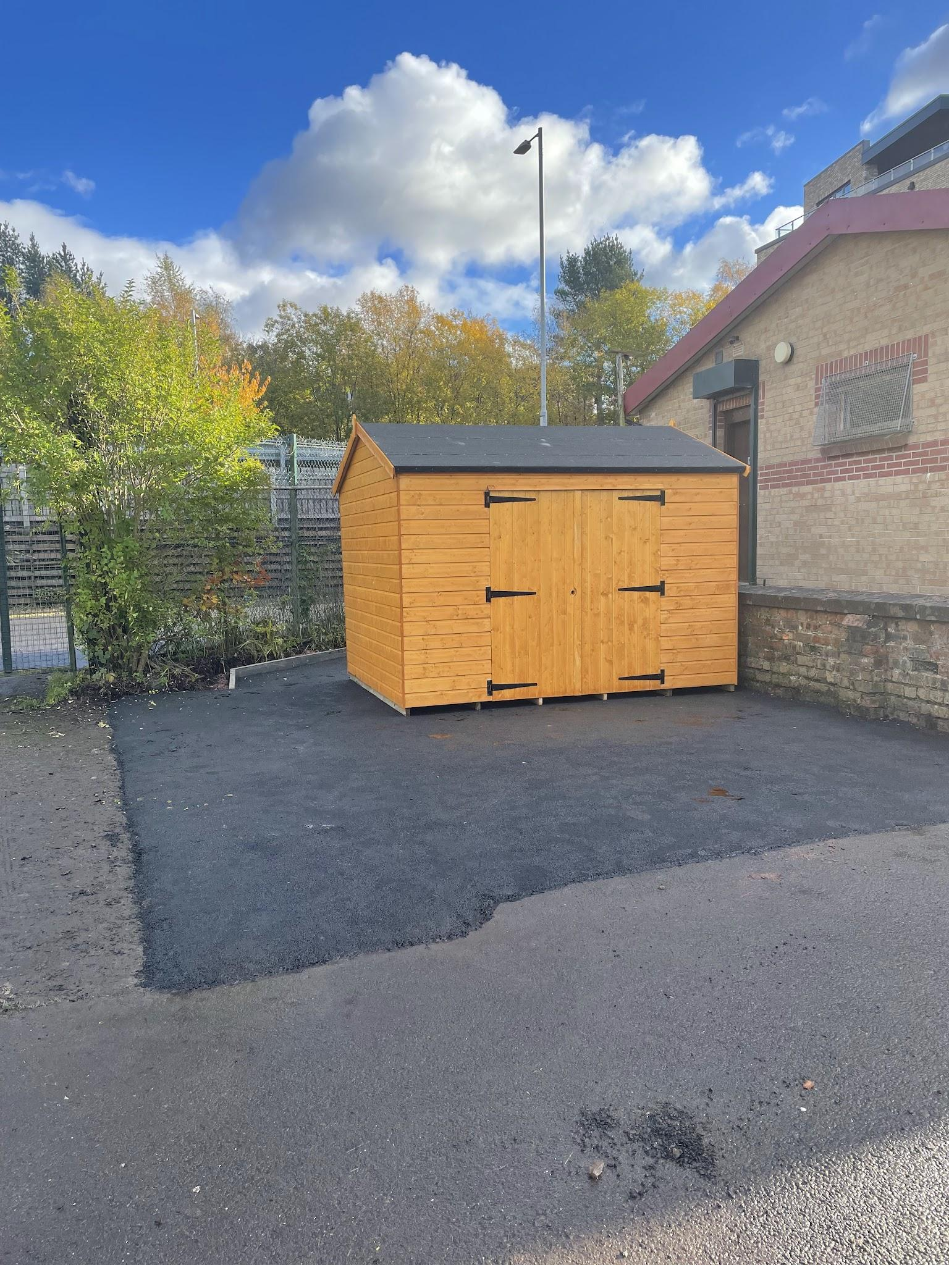
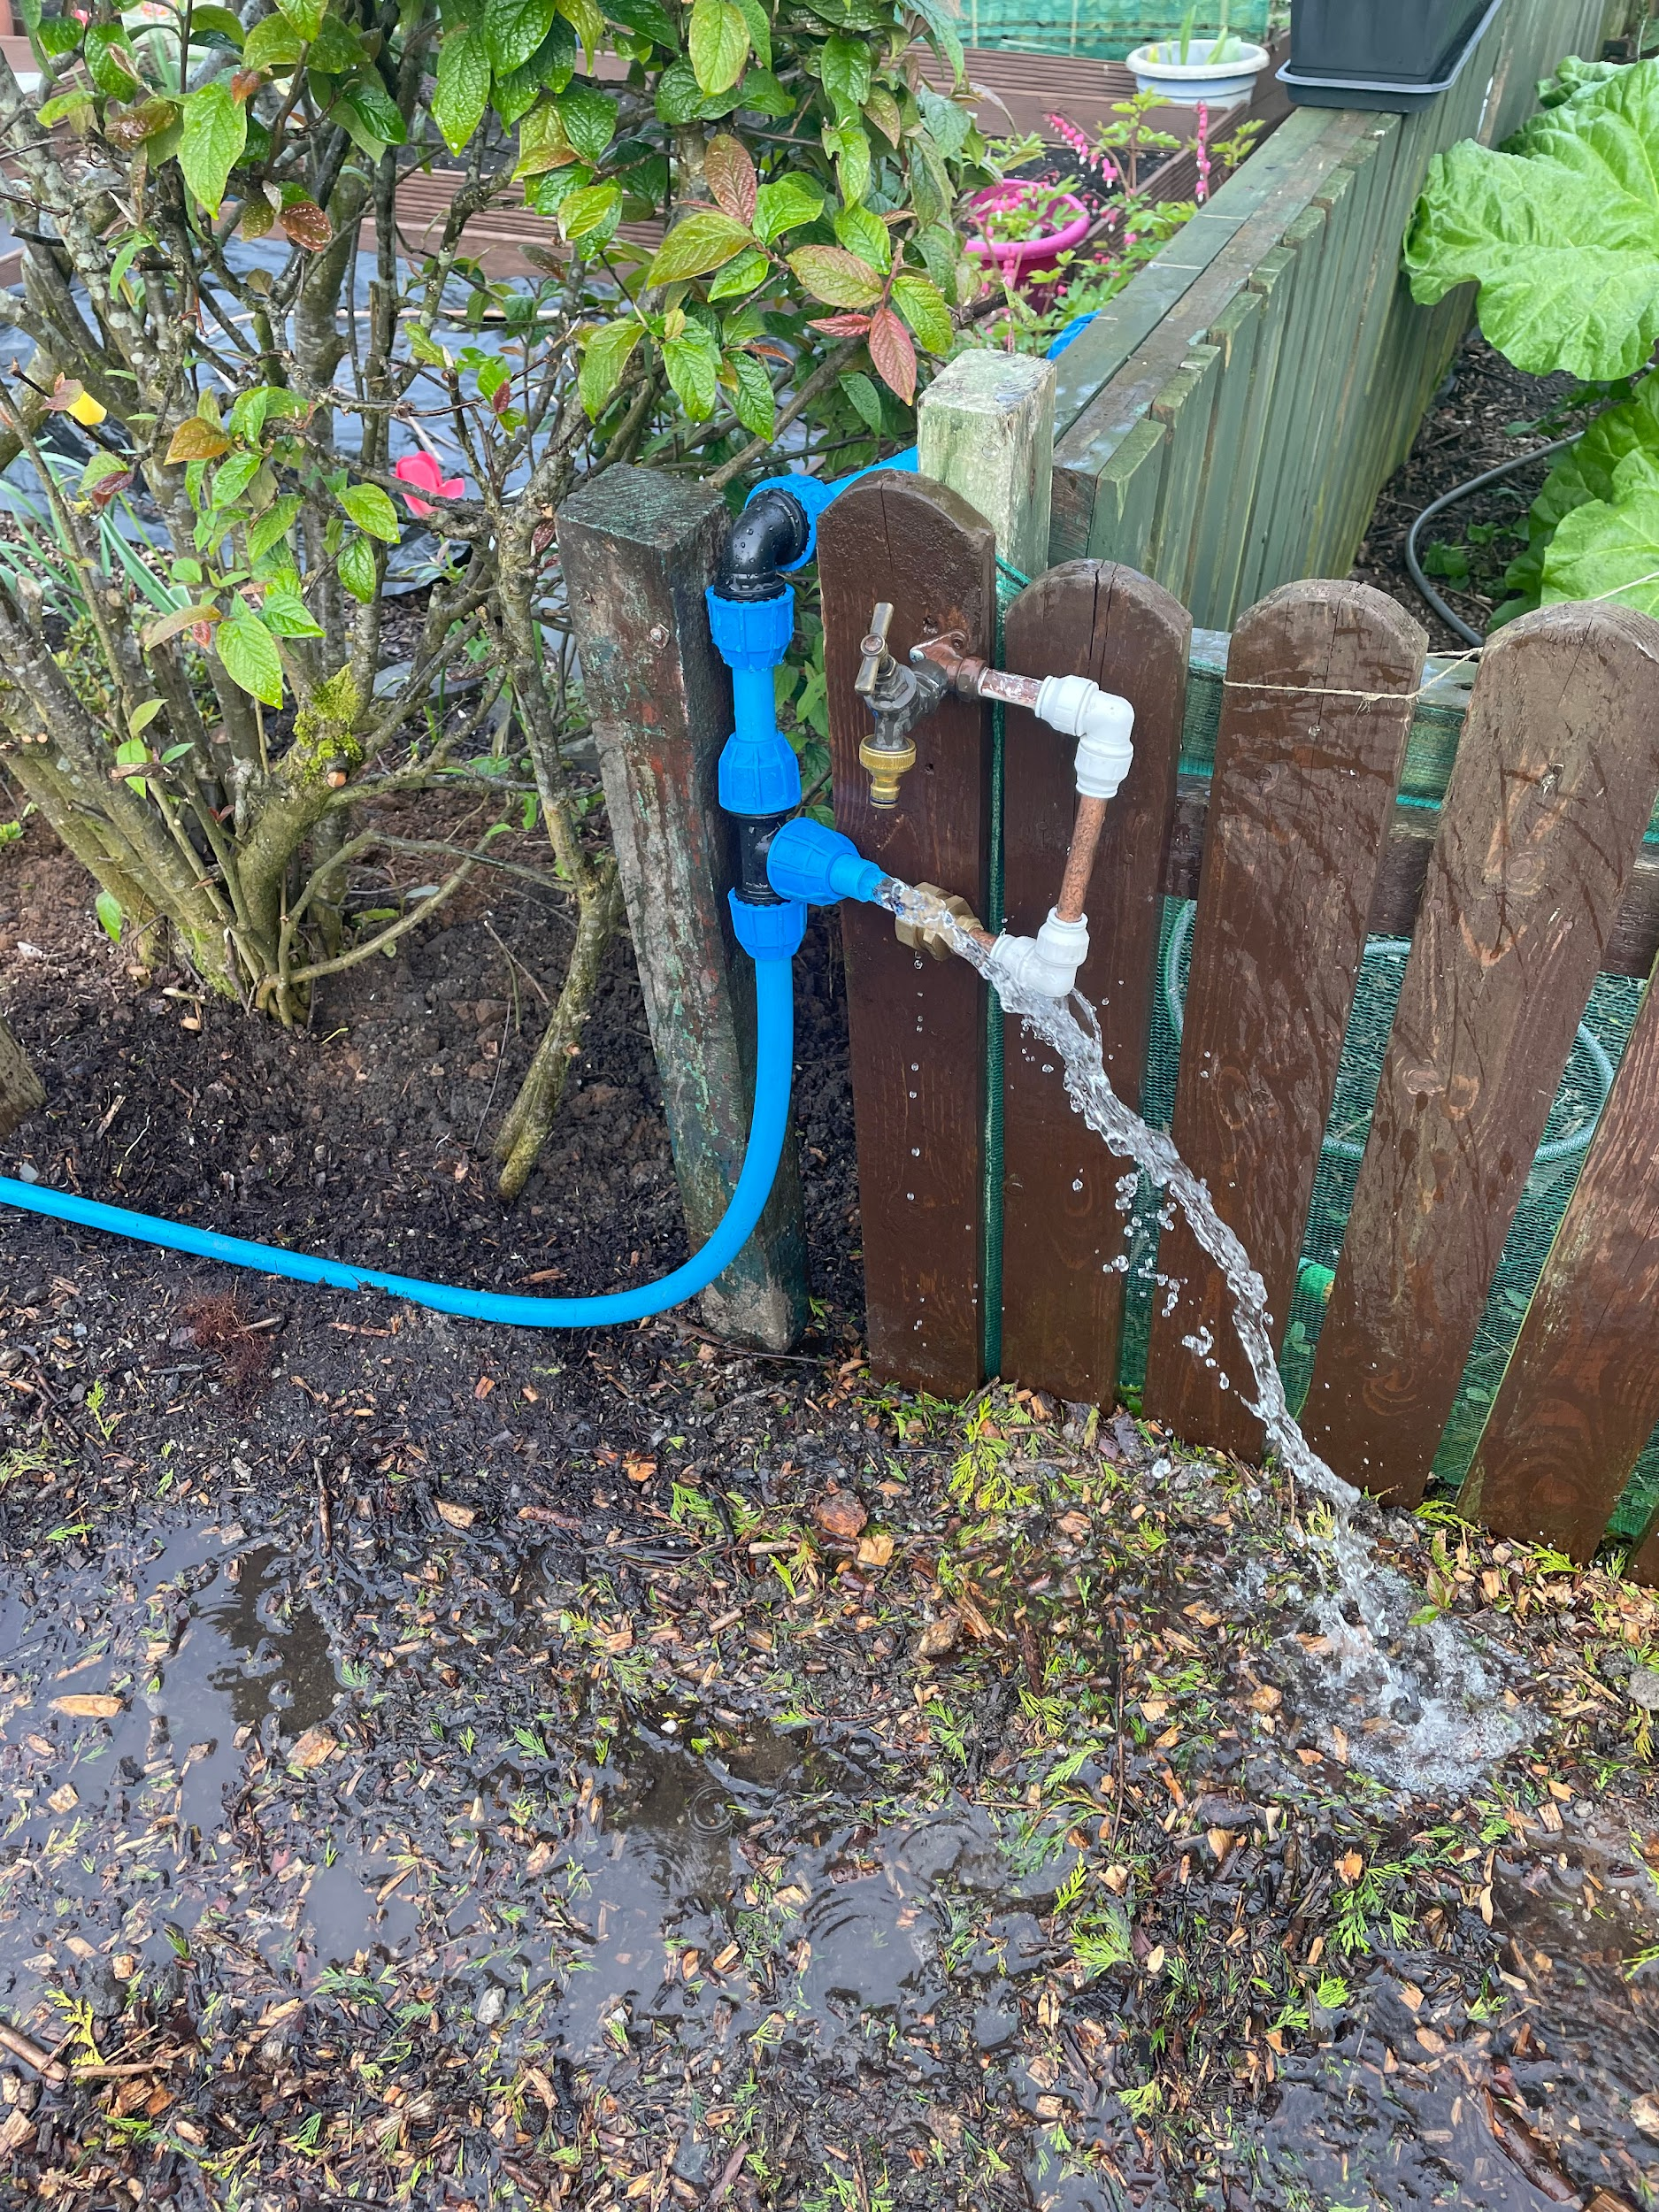
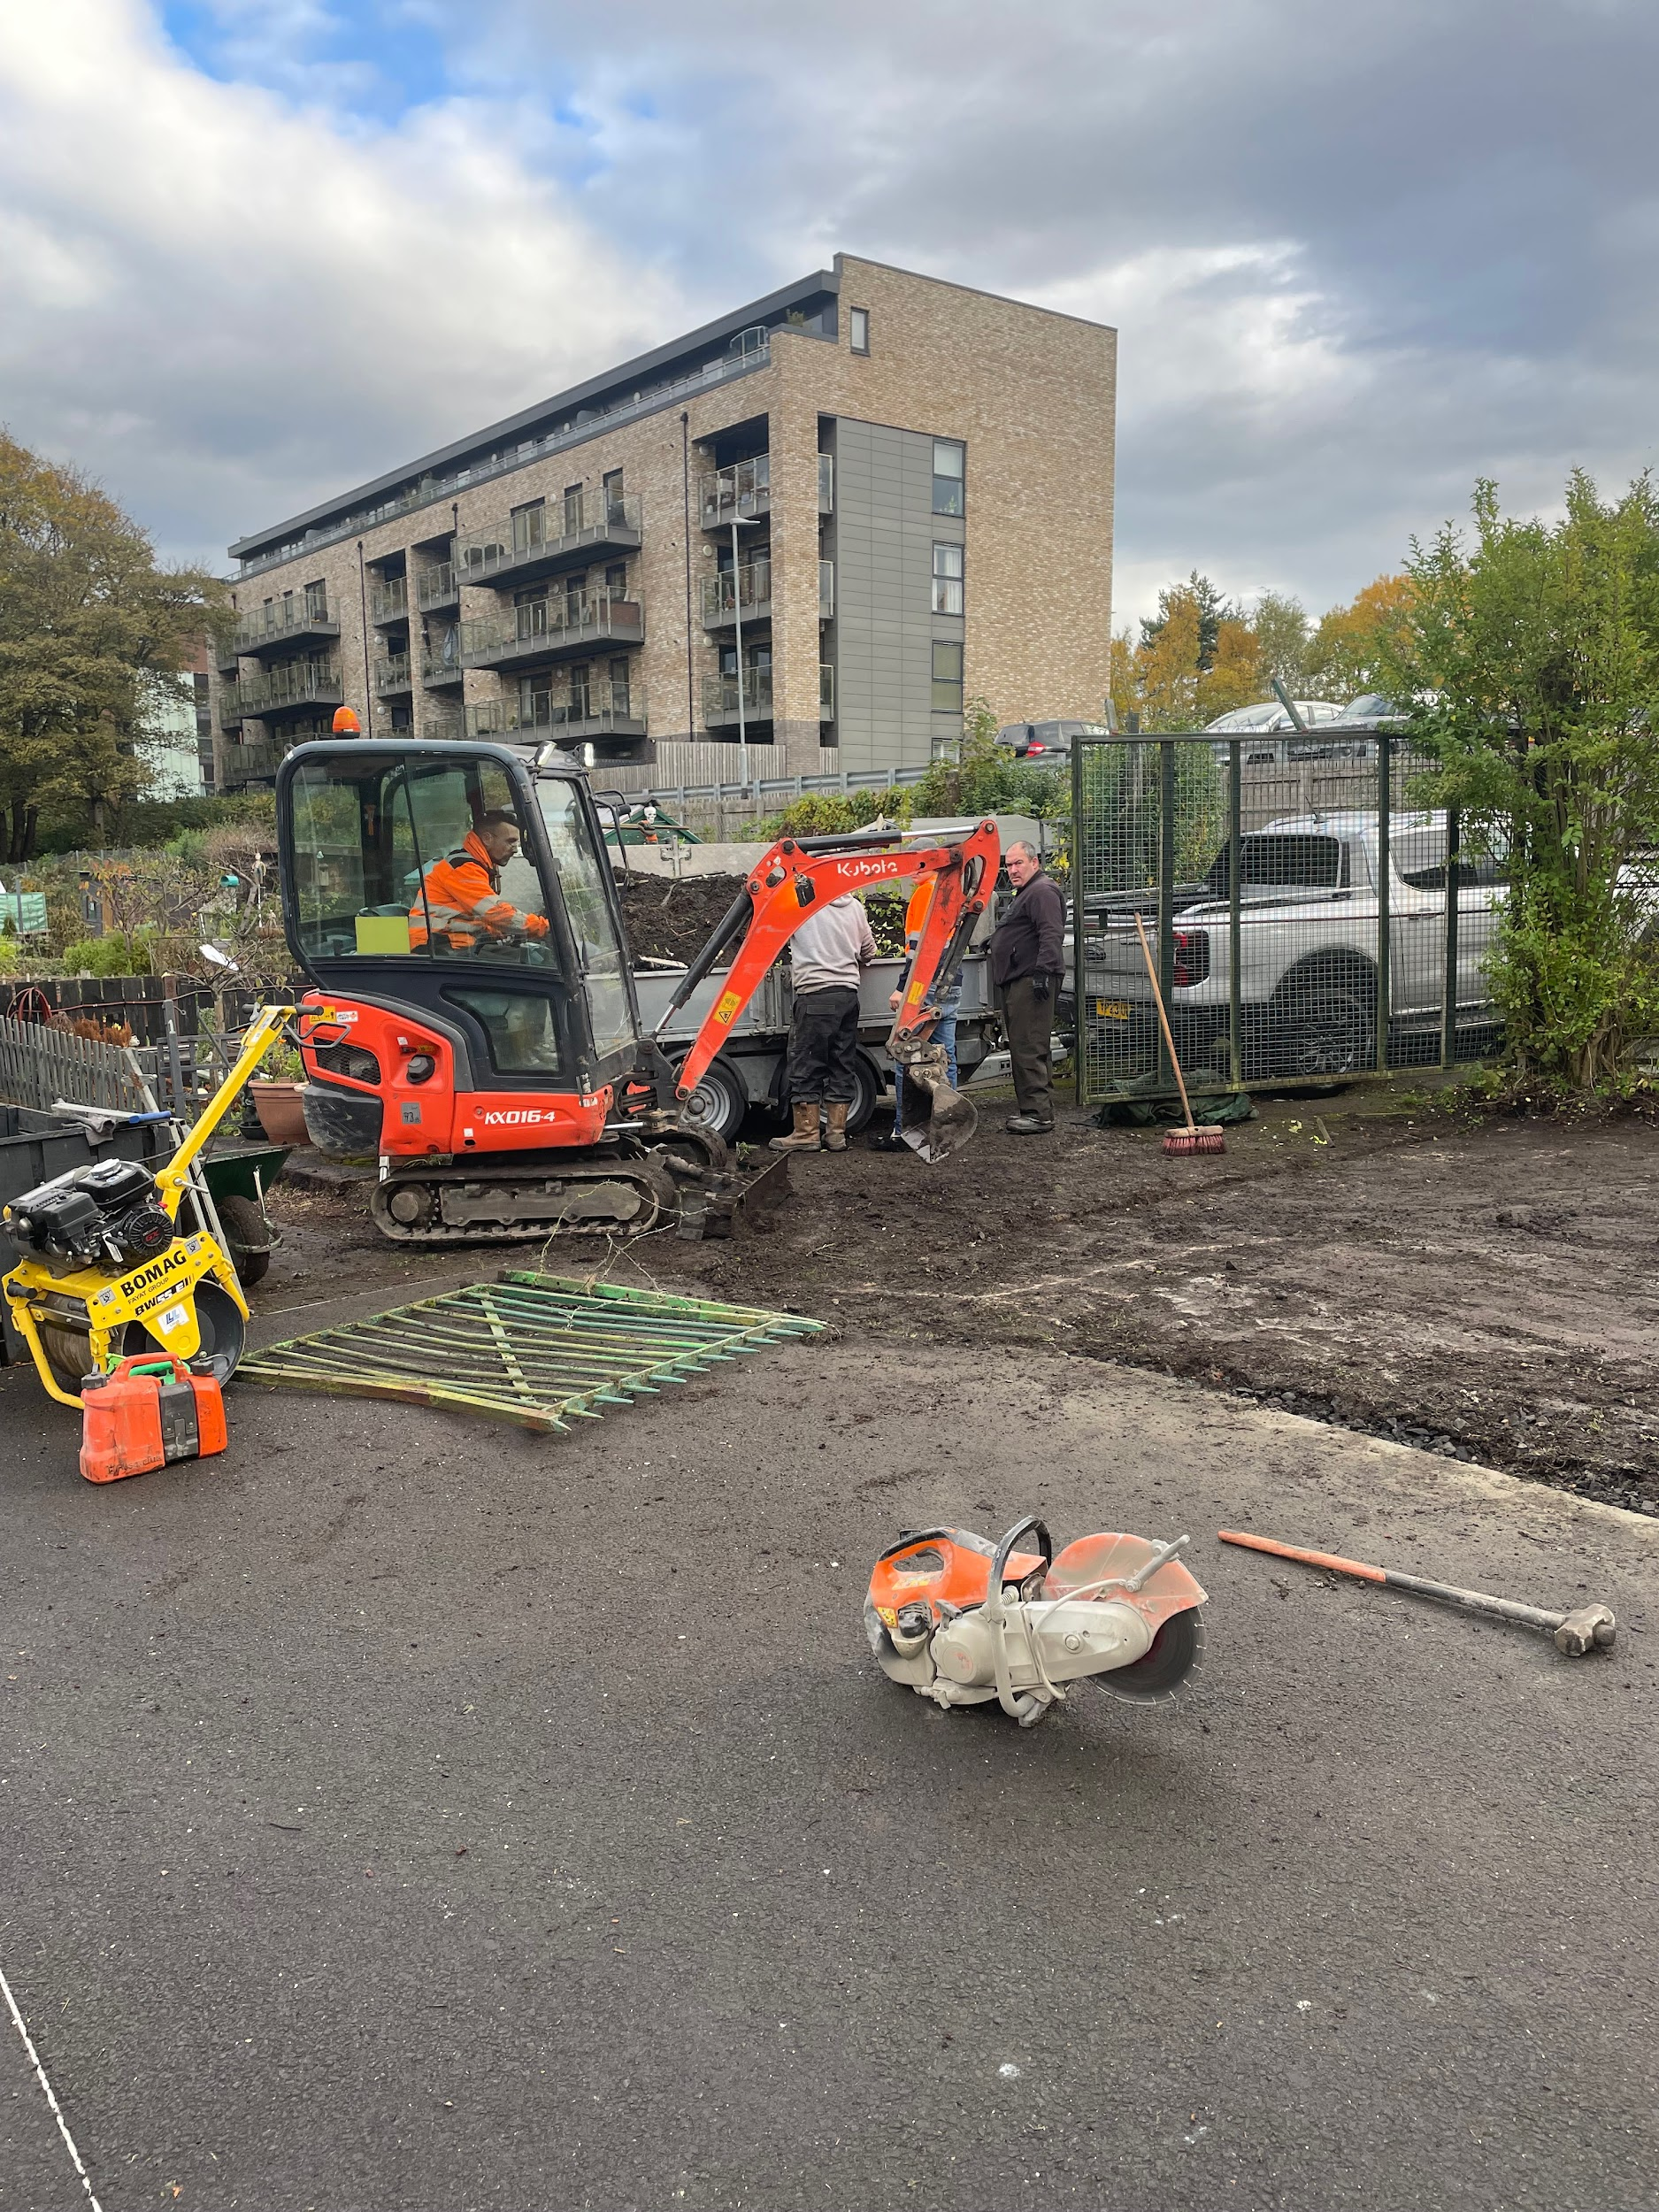
Services:
Shed and tarmac to communal area
Pavilion outdoor socket
Septic Tank emptied
18 plots changed hands
Plumbing upgrades
Two full sized skips
Council waste cages
Compost bulk delivery
GAF Potato Day
Free bark deliveries

Slide 4
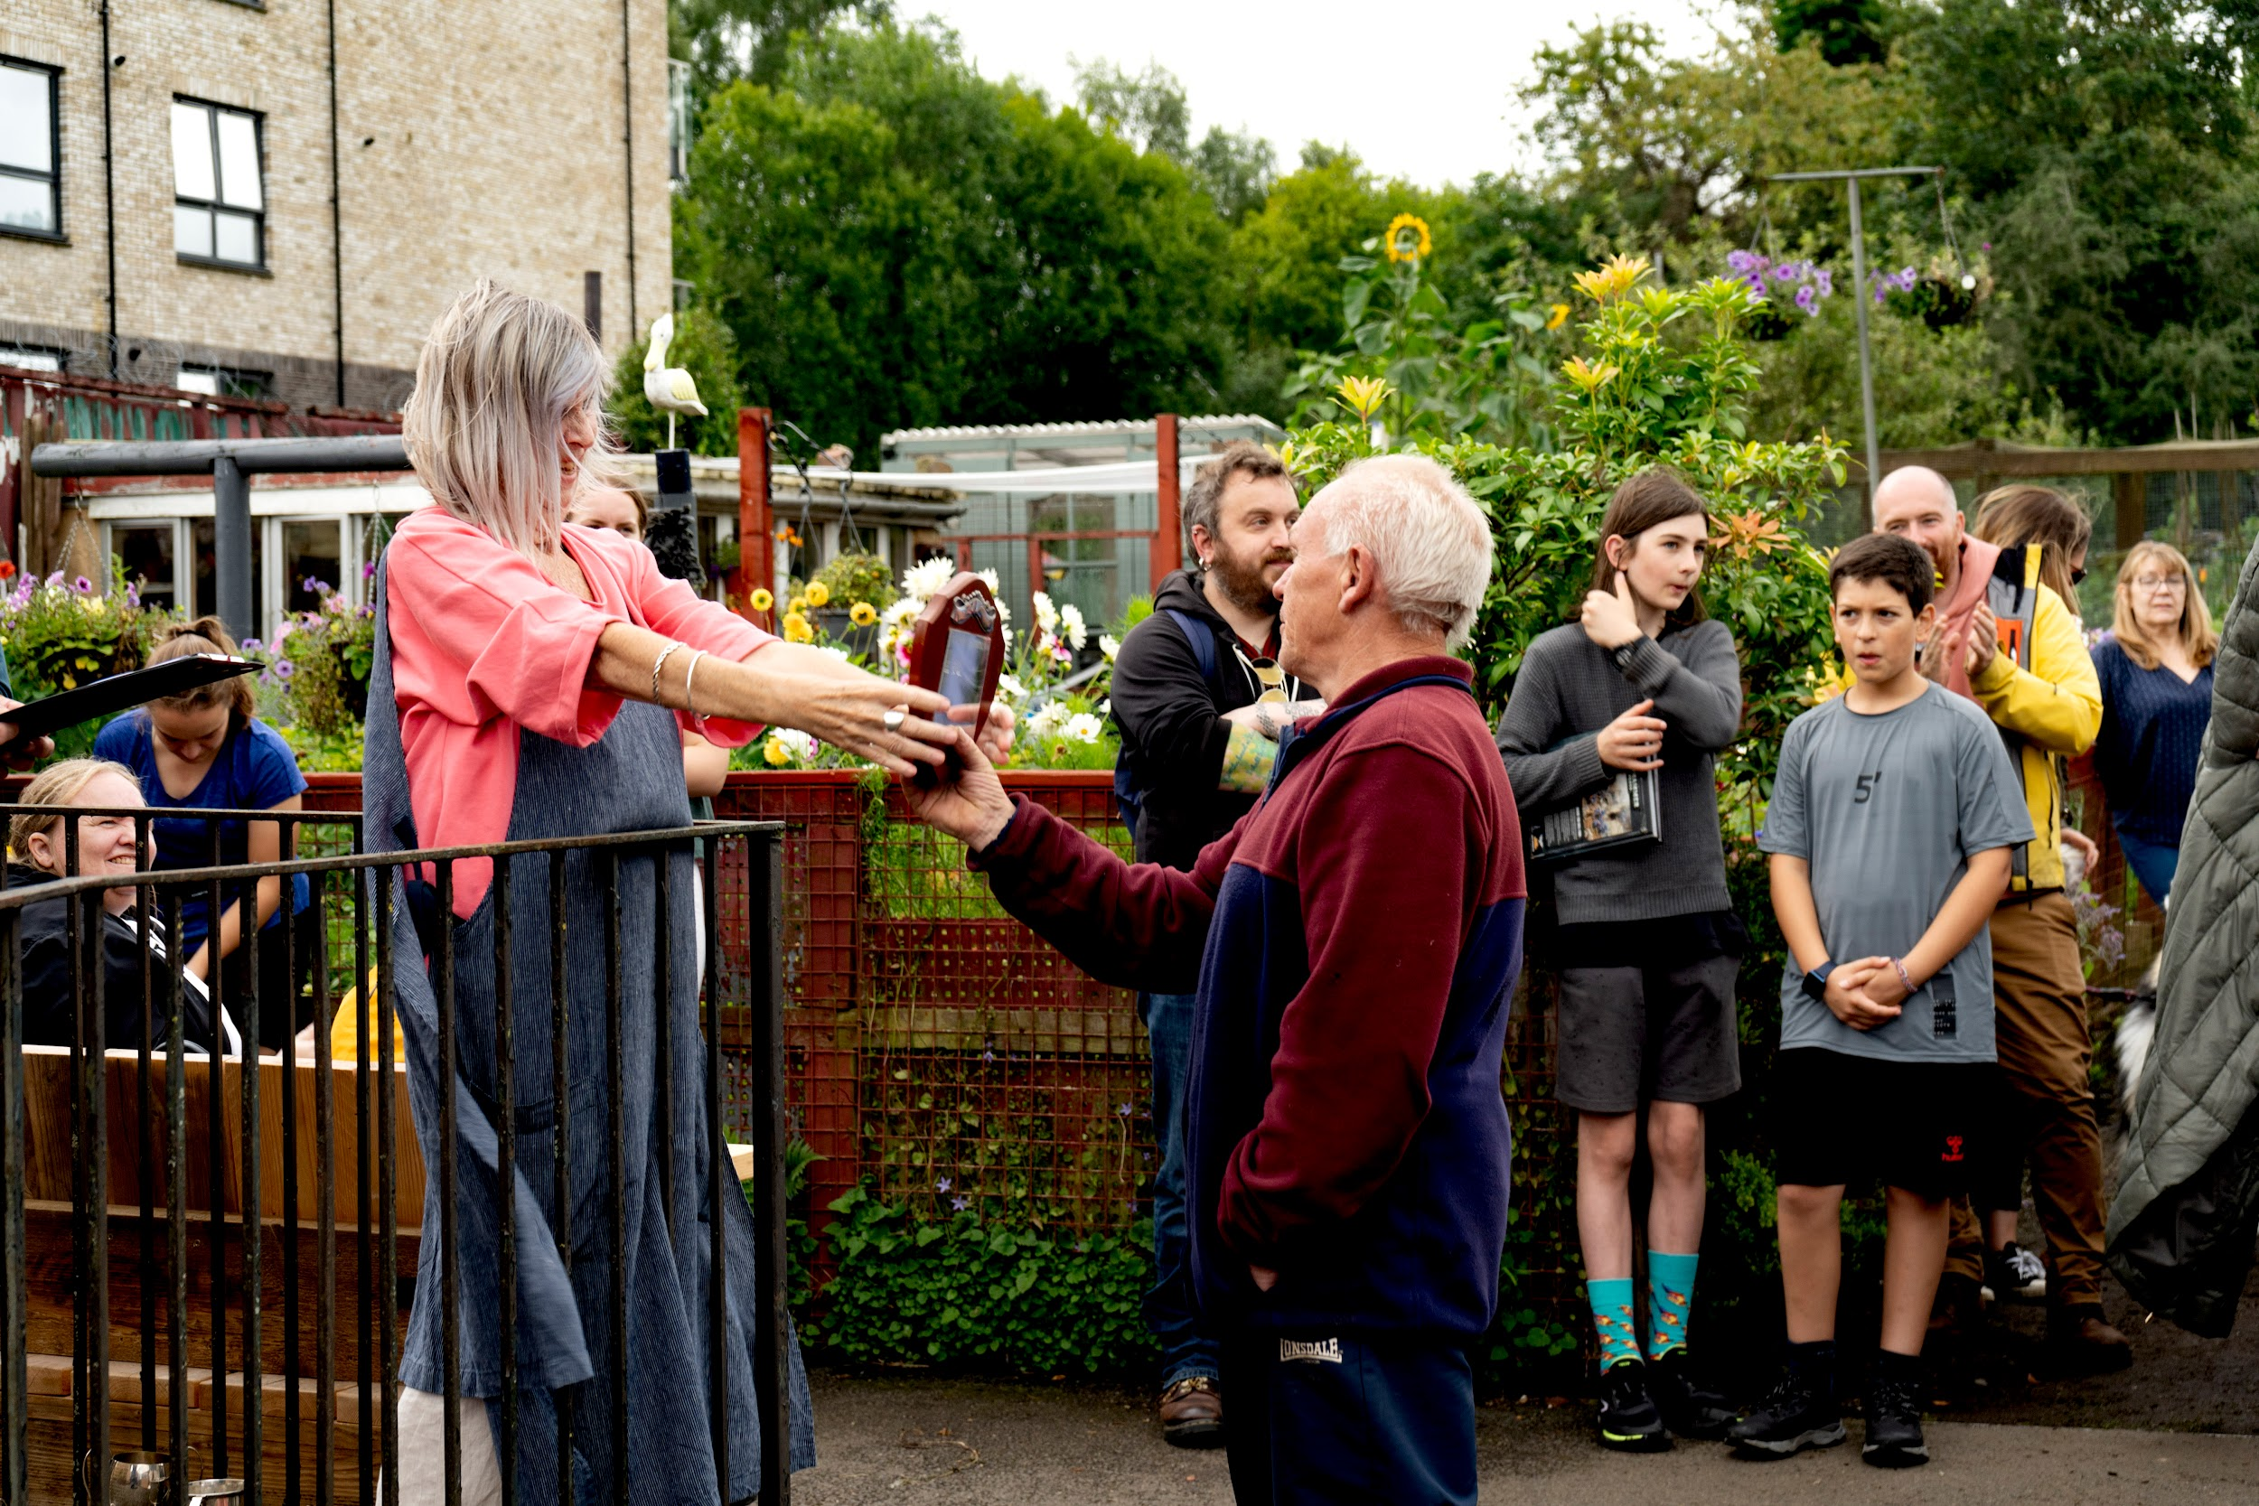
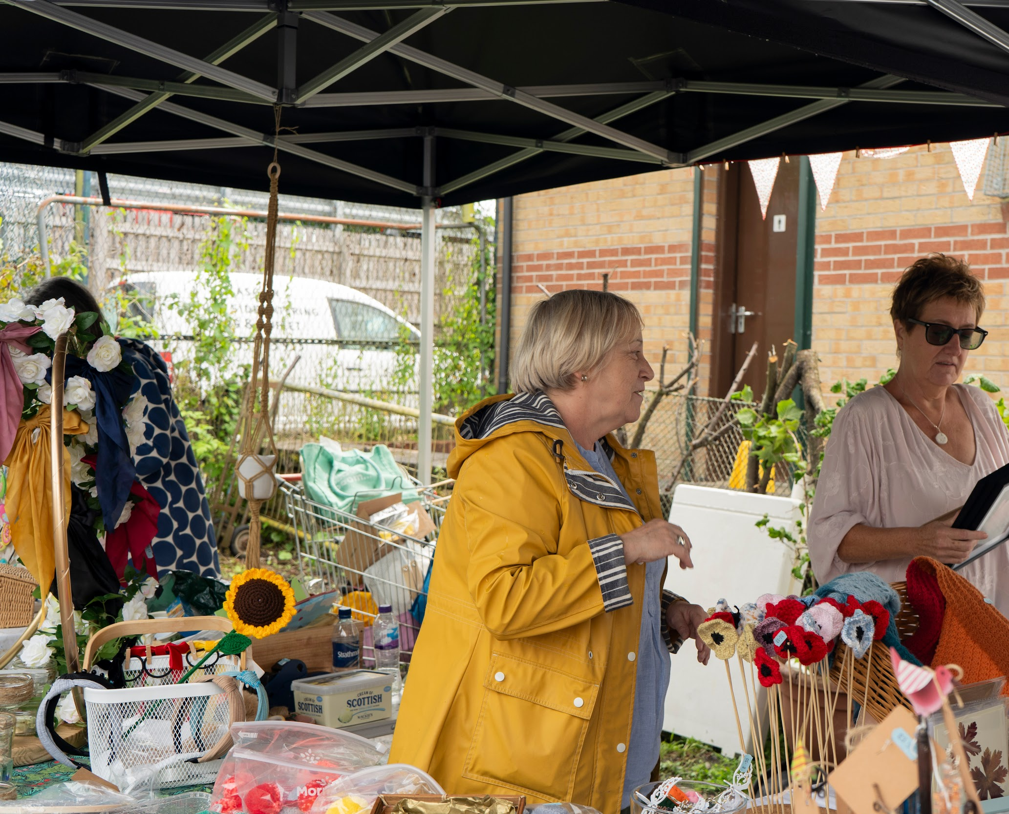
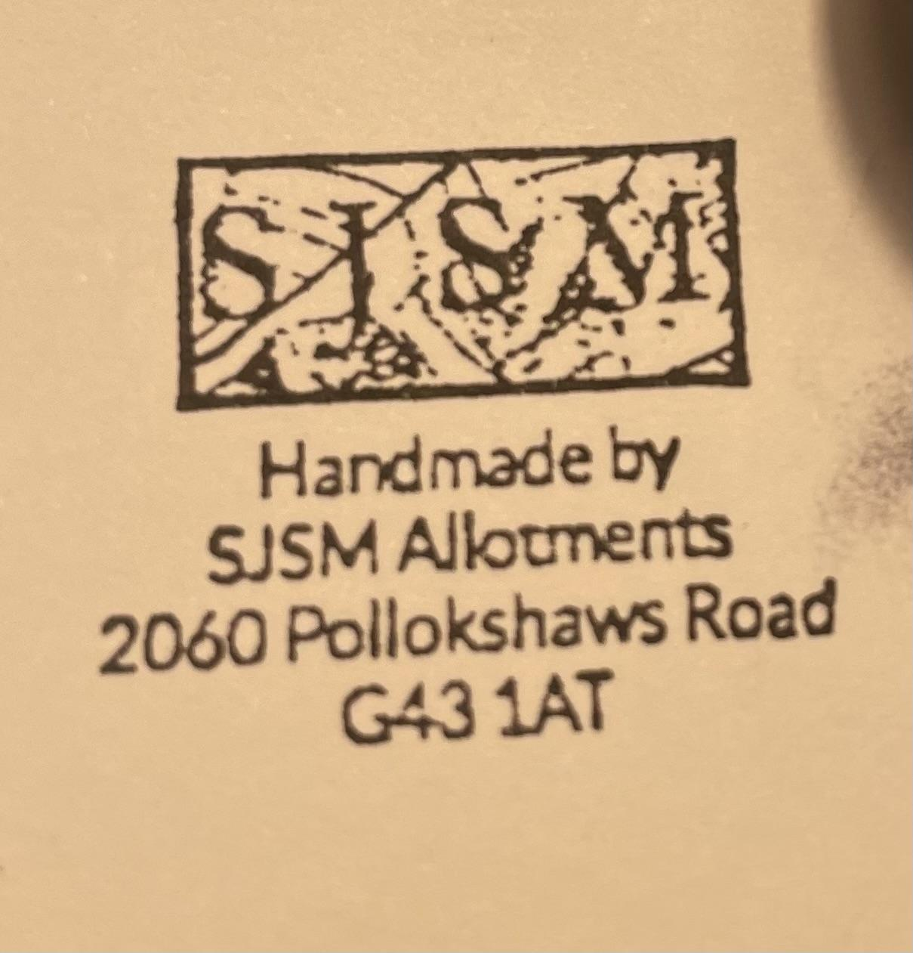
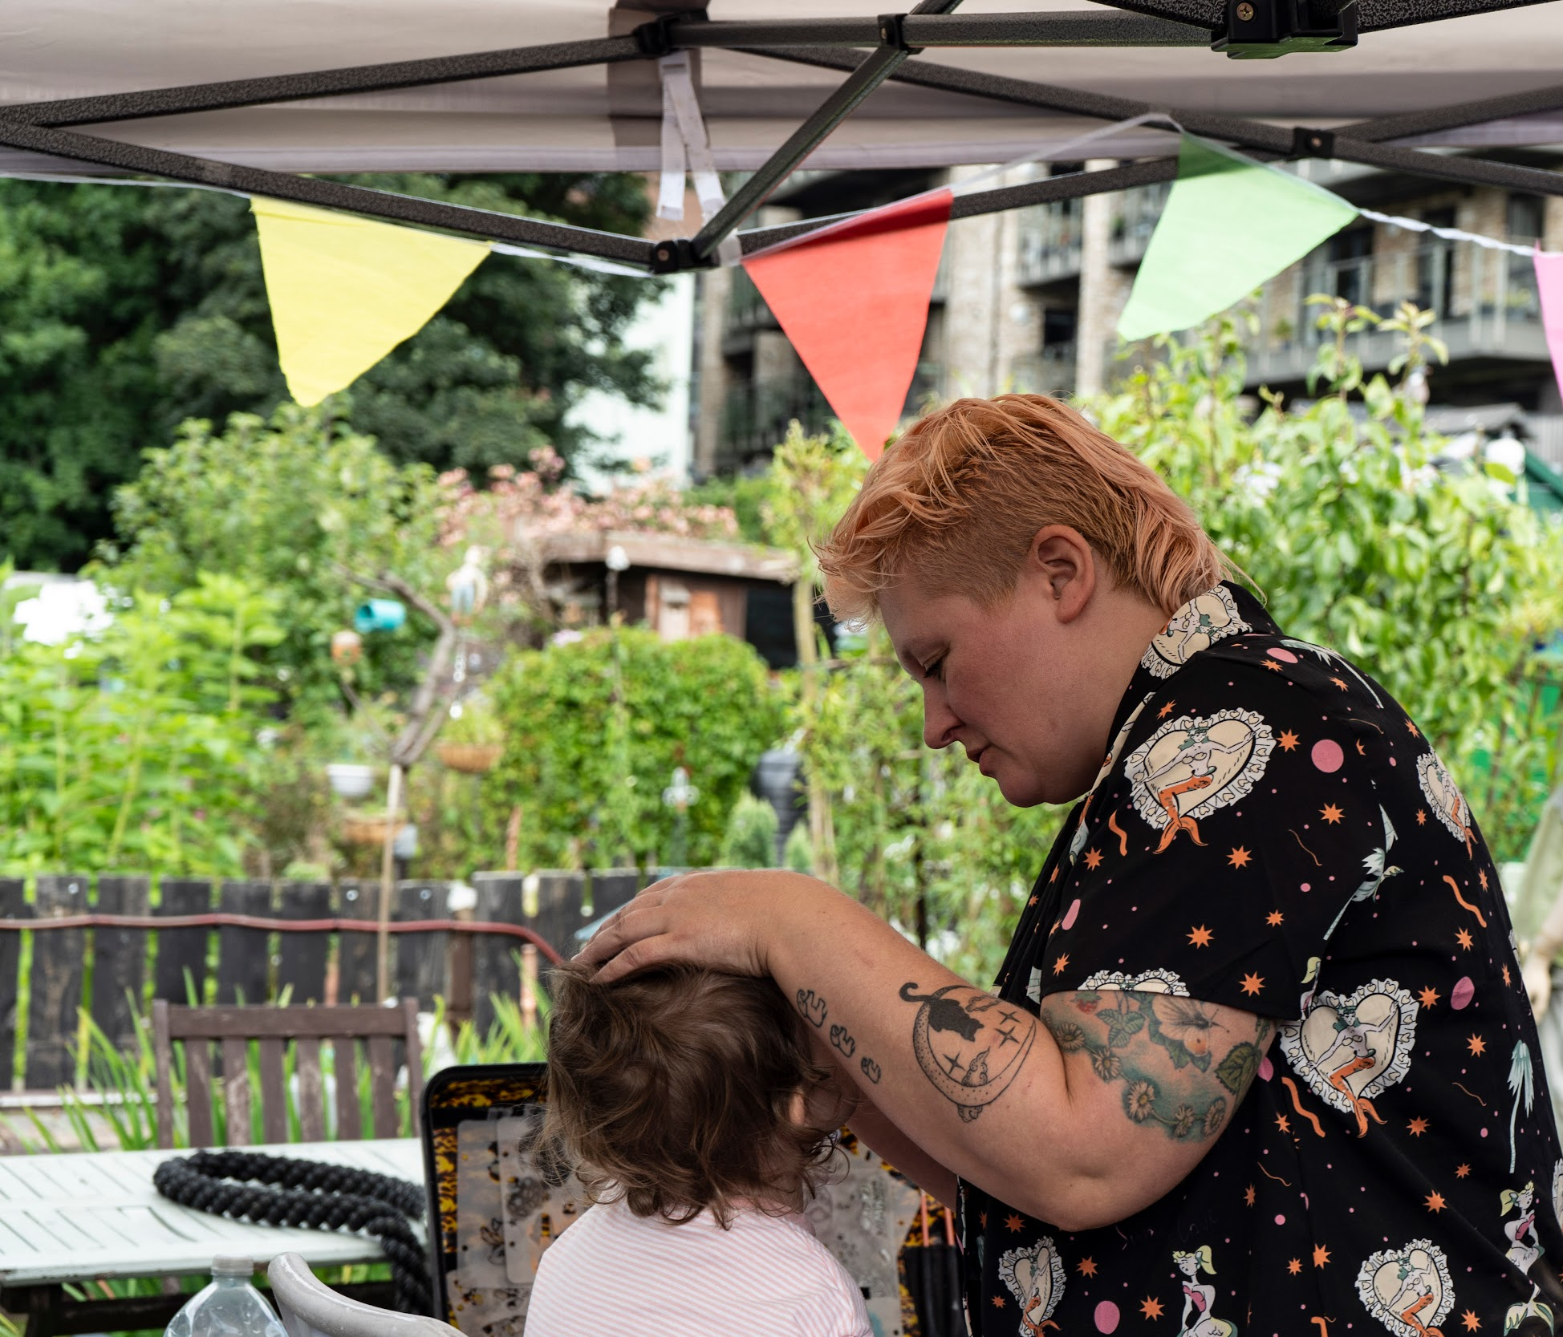
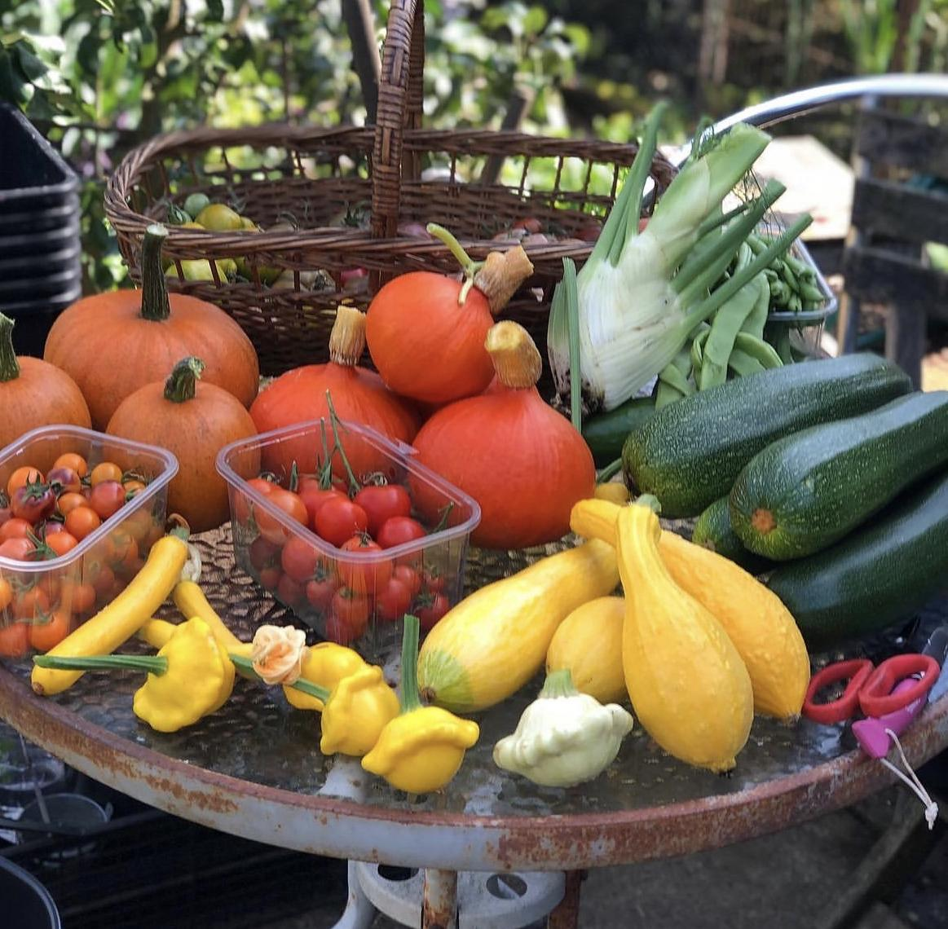
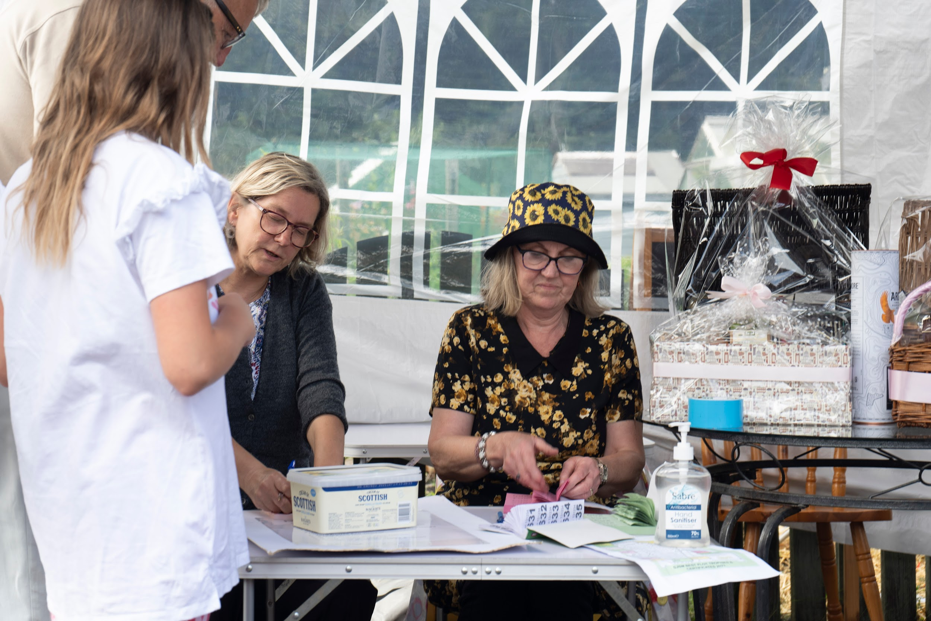
Open Day Recommendations:
More volunteers
Directions and no parking signs
Raffle prizes to be ranked
Signage for toilets esp. gents
Count numbers leaving
Donation sign at entrance clearer
Crafts to be members’ items only
Bee information stand included
Continue with foodbank donation

Slide 5
Open Day Sub Committee Recommendation:
Terms of Reference: Agreed Delegated
Budget e.g. £700
Member Comms Coordinator (Helen M)
Tombola & Raffle Coordinator (Julie D)
Set Up & Gate Coordinator (Michelle J)
Flowers & Plants Coordinator
Cafe and Home Baking Coordinator
Produce & Preserves Coordinator
Children’s Events Coordinator
Judging, Awards & Scarecrow Competition Coordinator
Crafts Coordinator (Anna T)
Social Media & Signage Coordinator

Slide 6
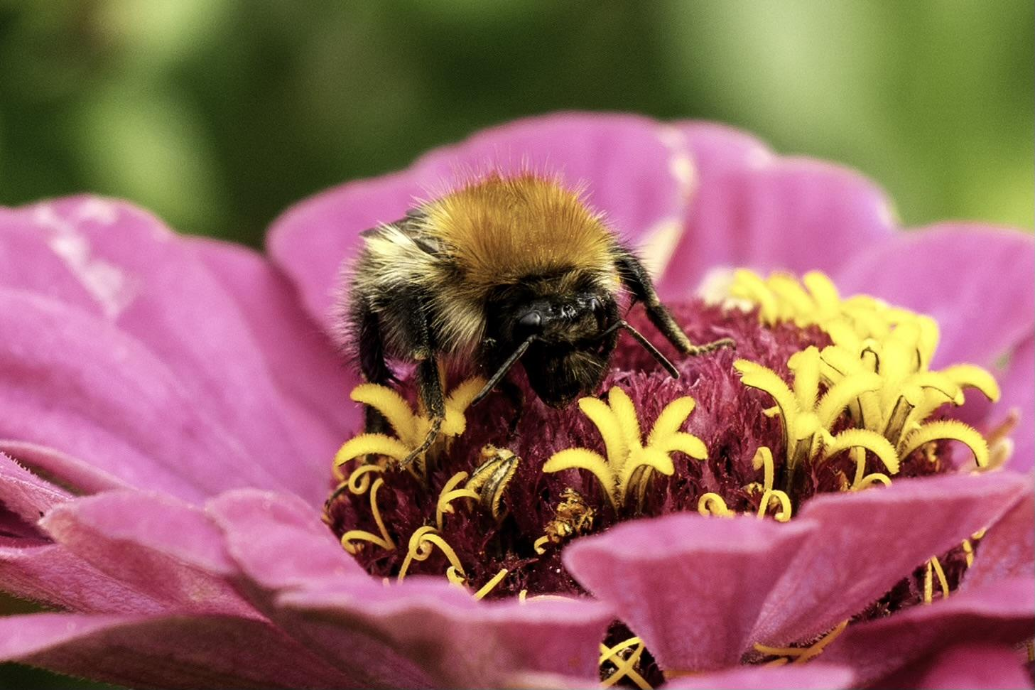
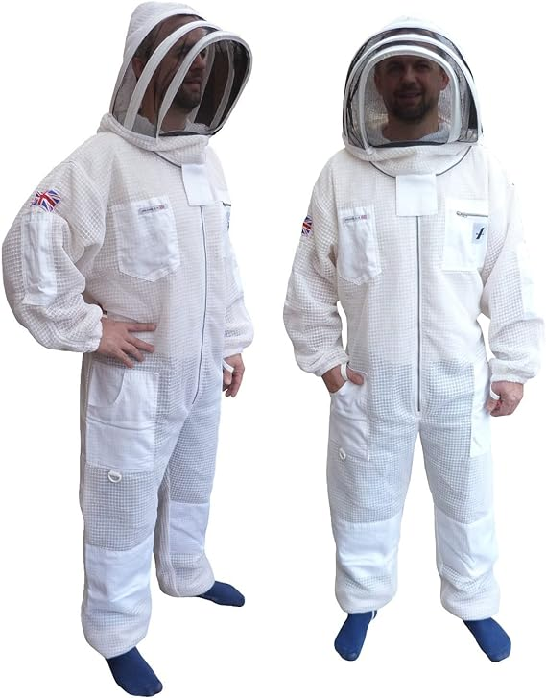
Future Events:
Open Day
Sunday 17th August
1.30pm to 4pm
Plot Judging July
Women’s Workshops in June: arts & crafts;
flower tying & bouquets
Twice Monthly Bee Observations

